Slide 1
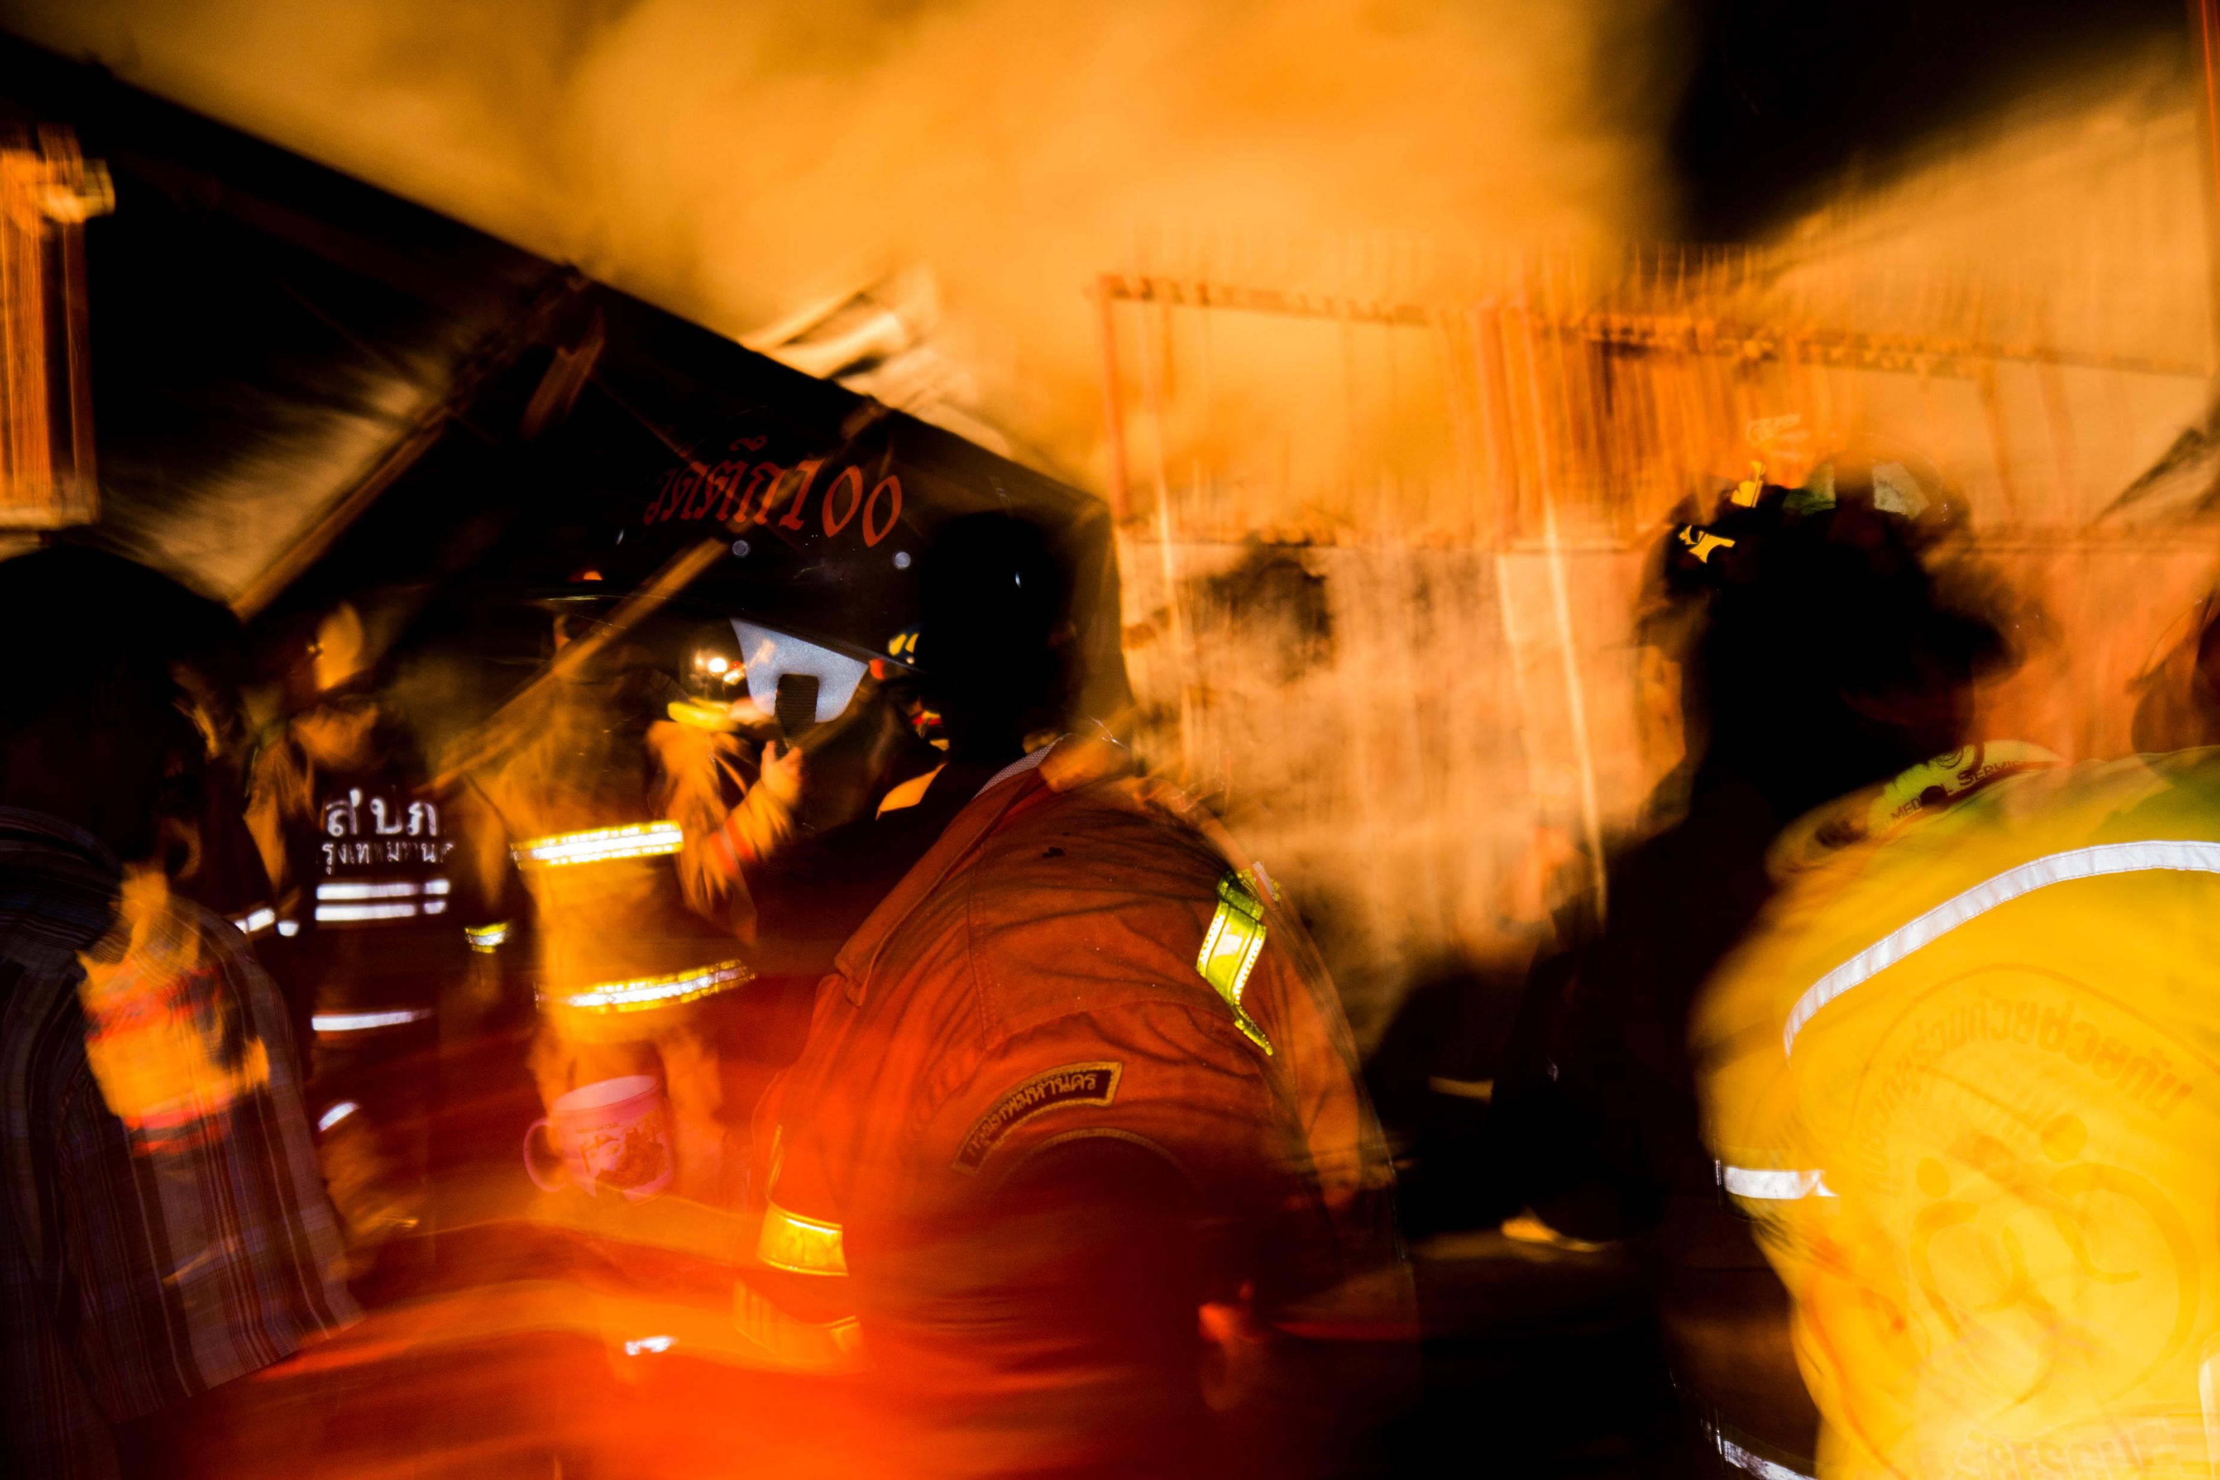
EMERGENCY MANAGEMENT DEVELOPMENT
Bonnie Austman
Emergency Management Coordinator
Yorkton Tribal Council
Bonnie.Austman@ytai.org
306-501-0235

Slide 2
EMERGENCY MANAGEMENT DEVELOPMENT
PURPOSE
Used as a guide to provide prompt and coordinated response to emergencies or disaster
Reduce human suffering and loss or damage to property and/or environment

Slide 3
EMERGENCY MANAGEMENT DEVELOPMENT
LEGISLATION
Provincial Emergency Management Act
Federal Emergency Management Act

Slide 4
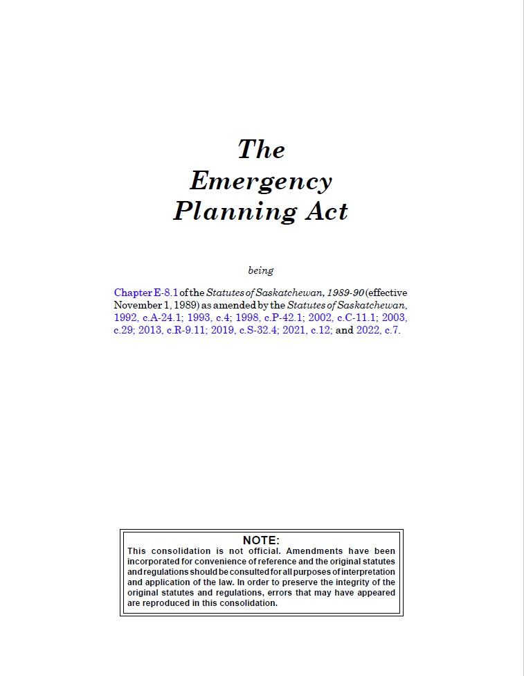
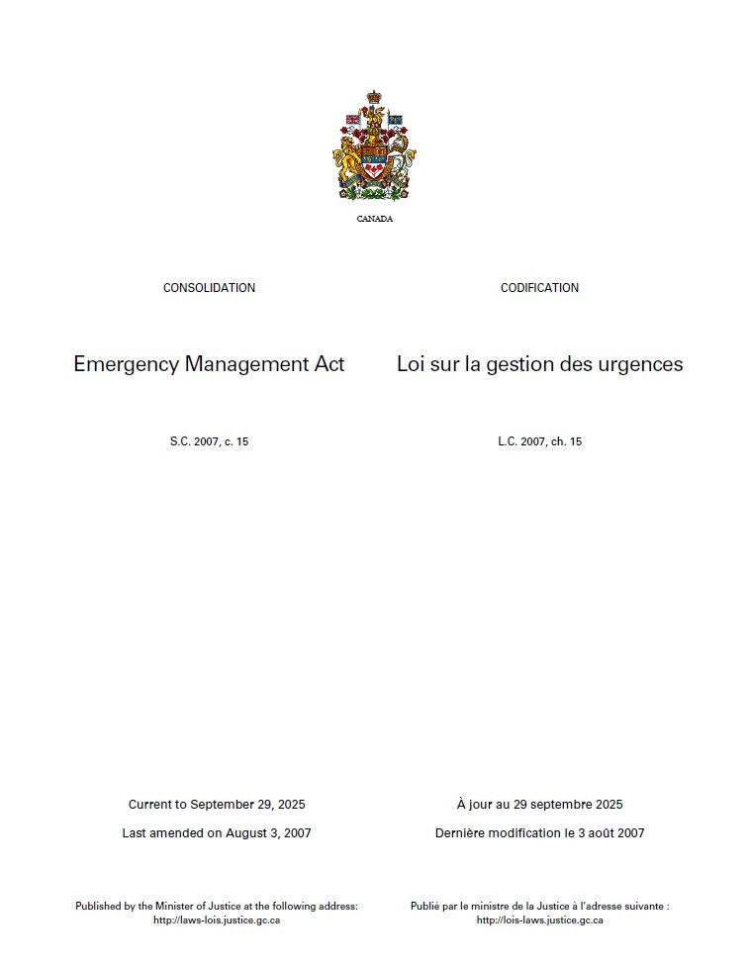

Slide 5
EMERGENCY MANAGEMENT DEVELOPMENT
Local emergency plans
9(1) Every local authority shall:
9. (1) (a) establish a local emergency measures organization;
(b) appoint a person as a local emergency measures co-ordinator; and
(c) establish a local emergency planning committee composed of:
(i) the emergency measures co-ordinator appointed pursuant to
clause (b); and
(ii) any other persons the local authority considers necessary.
(2) The emergency measures co-ordinator is the chairperson of the local emergency
planning committee.
(3) Every local emergency planning committee shall establish a municipal
emergency plan governing:
(a) the provision of necessary services during an emergency; and
(b) the procedures under and the manner in which persons will respond to
an emergency.
Notes:
This slide as per Sask Emergency Planning Act.

Slide 6
EMERGENCY MANAGEMENT DEVELOPMENT
AUTHORITY
Chief and Council are responsible to pass a Band Council Resolution to develop an Emergency Plan.
Chief and Council must pass a Band Council Resolution to appoint an Emergency Coordinator and appoint a Committee.

Slide 7
EMERGENCY MANAGEMENT DEVELOPMENT
WHY
Save lives
Save money
Locate resources and equipment
Identify major risks to community
Legislation

Slide 8
EMERGENCY MANAGEMENT DEVELOPMENT
ROLES AND RESPONSIBILITIES
- Emergency Coordinator
- Chief and Council
- Emergency Committee
Notes:
The plan defines the roles and responsibilities for each position. As per the roles and responsibility handout.

Slide 9
EMERGENCY MANAGEMENT DEVELOPMENT
WHAT IS AN EMERGENCY PLAN
Identifies the roles and responsibility of the Chief and Council and the EM Coordinator
Identifies risks to the community
Identifies how the community will respond to the identified risks
Identifies resources in the community
Notes:
After Band resolution to establish an Emergency Management Committee and Coordinator, next step is to do risk assessment, identify how these risks might be delt with and identify the resources within the community to help mitigate these risks. The resource list should also include outside resources and partners. Some of the outside resources may require prior agreements or MOU’s.

Slide 10
EMERGENCY MANAGEMENT DEVELOPMENT
IDENTIFY RISKS/HAZARDS AND ANALYZE
A hazard has the potential or existing condition that may cause harm to people or damage to property and the environment
Identify the impact it may have on your community

Slide 11
EMERGENCY MANAGEMENT DEVELOPMENT
NATURAL
• Severe Weather (wind storms, tornadoes, hail, heavy rain, blizzards)
• Floods
• Wildfires (grass fires, wildland/urban interface and forest fires)

Slide 12
EMERGENCY MANAGEMENT DEVELOPMENT
HUMAN CAUSED
• Infrastructure failure, (transportation corridors, bridges, municipal infrastructure, information technologies)
• Power and energy failures
• Transportation incidents (road, rail, water or air) *
• Wildland/Structural fires
• Health pandemics
• Chemical, biological, radiological and nuclear accidents
• Acts of terrorism
• Civil unrest or insurrection
• Cyber attacks
*Mass casualty

Slide 13
EMERGENCY MANAGEMENT DEVELOPMENT
EMERGENCY PLAN DEVELOPMENT
EM Committee to develop plans for each risks
Identify what resources in community
Approach surrounding communities/RM’s in regard to Mutual Aid
Identify a location for an Operations Center
Identify a location for an Evacuation Center
Notes:
Operations Center and Evacuation Center should be 2 different locations if possible

Slide 14
EMERGENCY MANAGEMENT DEVELOPMENT
COMPONENTS OF THE PLAN
PURPOSE
Guide used for a prompt and coordinated response to emergencies or disasters to reduce human suffering and loss or damage to property and environment. Does not apply to day to day situations
Notes:
After this presentation, I will go through an Emergency Management Plan Template that is provided in your training package.

Slide 15
EMERGENCY MANAGEMENT DEVELOPMENT
AUTHORITY
By Band Council Resolution Number and Dated
Attach copy of the Resolution as an Addendum
Notes:
Written into plan.

Slide 16
EMERGENCY MANAGEMENT DEVELOPMENT
DEFINITIONS
Disaster
Emergency
Declaration of a Local State of Emergency
Emergency Operations Center
Evacuation

Slide 17
EMERGENCY MANAGEMENT DEVELOPMENT
IMPLEMENTATION
- Authorized by
- Chief
- In absence of Chief, Council
- In absence of Chief and Council, Emergency Coordinator
- Other Emergency Personnel designated by Plan
Notes:
As per State of Local Emergency handout.

Slide 18
EMERGENCY MANAGEMENT DEVELOPMENT
COMMUNICATIONS
- Post names of Emergency Coordinator/Alternate if community members see something that poses a threat to their community
- Public Notices posted throughout the community

Slide 19
EMERGENCY MANAGEMENT DEVELOPMENT
IDENTIFY RISKS
- Wildland/Interface fires
- Structural Fires
- Power Outage (winter/summer)
- Winter Storms
- Plow Winds/Tornadoes
- Water/Sewage Treatment Plant failures
- Epidemic
- Damaged infrastructure
- others as identified by the Committee

Slide 20
EMERGENCY MANAGEMENT DEVELOPMENT
LIST OF CONTACTS
- Emergency Committee members
- Emergency Management Coordinator/Alternate
- Public Works Manager/Alternate
- Transportation Manager/Alternate
- Human Resources/Volunteer Manager
- Communications Manager/Alternate
- Emergency Services Coordinator
- Public Information Manager
- Security

Slide 21
EMERGENCY MANAGEMENT DEVELOPMENT
CONTACT LIST
- Band Members List
- Chief and Council
- Director of Operations
- Finance
- Resources

Slide 22
EMERGENCY MANAGEMENT DEVELOPMENT
AGENCY CONTACTS
- RCMP
- Ambulance
- Search and Rescue
- Local Hospitals
- Environmental Health Officer
- Red Cross
- SaskPower
- SaskTel
- SaskEnergy
- Others identified
Notes:
Other can include Band Fire Dept and contact info for neighboring Fire Dept’s

Slide 23
EMERGENCY MANAGEMENT DEVELOPMENT
EMERGENCY EQUIPMENT CONTACTS
- Jaws of Life
- Tow Trucks
- Heavy Equipment Operators
- Generators
- Snowmobiles/ATV/UTV
- Boats
- Four Wheel Drive Trucks

Slide 24
EMERGENCY MANAGEMENT DEVELOPMENT
EMERGENCY COMMUNICATIONS CONTACT
- Radio stations
- TV Stations
- Social Media
- Newspaper
- Other (Voyent Alert, Talking Stick App)
Notes:
Be aware that Radio/TV and newspaper may cause a media frenzie. Social media and other apps are controlled by the user.

Slide 25
EMERGENCY MANAGEMENT DEVELOPMENT
WORK PLANS FOR IDENTIFIED RISKS
- Major Effects
- Potential Actions
- Responsible Agency
- Required local resources/equipment required
- Mutual Aid
- Evacuations
- Search and Rescue
- Declaration of State of Local Emergency
Notes:
Responsible agency – Health takes lead for pandemics, Fire Dept takes lead for fire emergencies, Public works – water treatment .
Evacuations – how can community members preplan for a community evacuation. Medications and supplies, personal hygiene, children comforts. (Red Cross Pillow Project)
Search and Rescue – RCMP lead, contacts SARSAV or Nation to Nation (PAGC or SSFNSAR)
Declaration – Example in training package

Slide 26
EMERGENCY MANAGEMENT DEVELOPMENT
MAJOR EFFECTS
- Disruption to community
- Danger to public safety
- Disruption to utilities
- Casualties/Trapped/Death
- Danger to Property
- Disruption to traffic
Notes:
Community – Emergency may take a lot of community members to mitigate
Utilities – Fire may burn utility poles resulting in power or telephone/internet outage
Traffic flow may be reduced due to evacuation, increased emergency traffic or compromised due to wildfire

Slide 27
EMERGENCY MANAGEMENT DEVELOPMENT
POTENTIAL ACTIONS
- Communication
- Rescue/Firefighting capabilities
- Eliminate hazards
- Mobile manpower and equipment
- Fire breaks/traffic control/EOC
Notes:
Communication – informing the community (at start of event and updates), starlink internet, radio communication, cellular/sat phones
Fire/Rescue – have mutual aid agreements to fill gaps in community fire dept services.

Slide 28
EMERGENCY MANAGEMENT DEVELOPMENT
RESPONSIBLE AGENCY
- Community Fire Department
- Mutual Aid
- SaskPower/Sasktel/SaskEnergy/Water Security
- Police/RCMP
- Health/Environmental
- Ambulance/Hospital/First Responders

Slide 29
EMERGENCY MANAGEMENT DEVELOPMENT
EQUIPMENT
- Firefighting equipment
- Ambulances
- Heavy equipment
- First Aid supplies
- Security
- Others defined

Slide 30
EMERGENCY MANAGEMENT DEVELOPMENT
AUTHORIZATION AND PUBLISHING
When the plan is completed, it must be approved by Chief and Council
Publish the plan and share with community members
Promote individual preparedness (72 hours)

Slide 31
EMERGENCY MANAGEMENT DEVELOPMENT
STATE OF LOCAL EMERGENCY (SoLE)
- A local state of emergency is declared for an abnormal event that is severe enough to:
- Cause loss of life.
- Result in serious harm or damage to the safety, health, or welfare of people.
- Lead to widespread damage to property or the environment.
- Potentially exceed the community's existing emergency response capabilities, requiring broader provincial support.
- Done by resolution of Chief and Council

Slide 32
EMERGENCY MANAGEMENT DEVELOPMENT
EVACUATIONS
- On First Nations, the decision to evacuate ultimately rests with the Chief and Council.
- In Canada, evacuation orders made by external agencies and provincial emergency management laws governing evacuations do not apply to reserve land unless the Chief and Council sign a resolution.
- Police or other agencies cannot legally remove residents who fail to comply.
- Evacuations may be recommended by provincial emergency operations centers, however, it is up to the Chief to order the evacuation.

Slide 33
EMERGENCY MANAGEMENT DEVELOPMENT
SEARCH AND RESCUE
- RCMP have the jurisdiction and should be notified as soon as possible.
- SARSAV is the provincial Search and Rescue organization which upon notification from the RCMP will mobilize the nearest search teams.
- First Nations may also activate the local SAR group by having a First Nation contact a First Nation that have a SAR team.

Slide 34
EMERGENCY MANAGEMENT DEVELOPMENT
SEARCH AND RESCUE
First Nations SAR teams
- PAGC Search Rescue Recovery – Prince Albert and area
- Prince Albert North SAR
- South Saskatchewan First Nations Search and Rescue – Based out of FHQTC and YTC

Slide 35
EMERGENCY MANAGEMENT DEVELOPMENT
SHELTER IN PLACE
- Taking refuge in doors in the event of an outside threat
- Tornadoes, plow winds, wildfire smoke, lock down are some examples

Slide 36
EMERGENCY MANAGEMENT DEVELOPMENT
MUTUAL AID AGREEMENTS
- Agreement to provide additional resources between First Nation to other First Nation
- Agreement to provide additional resources with local municipalities/RM’s or other entity

Slide 37
EMERGENCY MANAGEMENT DEVELOPMENT
EXERCISES
- Table top exercise
- Specific (rail/water/haz mat/etc.)
- Full mock deployment
- Used to test the plan, review and renew

Slide 38
EMERGENCY MANAGEMENT DEVELOPMENT
OTHER PLANS REQUIRED
- Water Treatment Plant
- Sewage Treatment Plant
- Band Hall/Owned Buildings
Notes:
Band Hall – Business Continuity

Slide 39
EMERGENCY MANAGEMENT DEVELOPMENT

Slide 40

EMERGENCY MANAGEMENT DEVELOPMENT
This Photo by Unknown Author is licensed under CC BY-SA-NC

