Slide 1
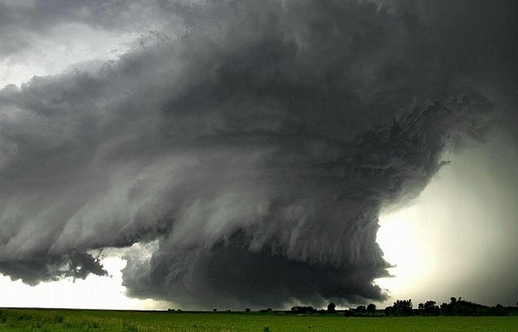
72 HOURS – IS YOUR FAMILY PREPARED?
AN EMERGENCY PREPAREDNESS PRESENTION
TO
EM FORUM, 27TH OCT 2025
Sandy Chess
Whitecap Dakota Nation
Emergency Management Coordinator
schess@whitecapdakota.com

Slide 2
YOU SHOULD BE PREPARED……
……to take care of yourself and your family for a minimum of 72 hours.
If a disaster happens in your community, it may take emergency workers some time to get to you as they help those in desperate need.
Learn these few simple steps today and help your family be prepared, not scared!

Slide 3
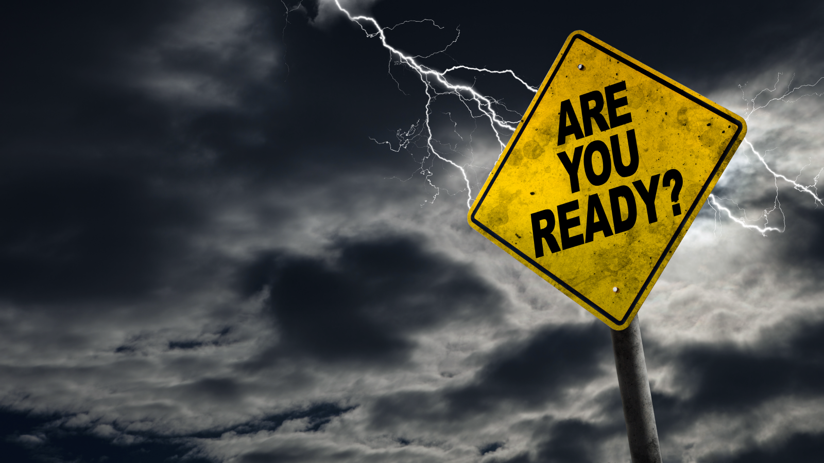
STEP 1: KNOW THE RISKS
Although the consequences of various
disasters can be similar, knowing the
risks in your region can help you
better prepare.

Slide 4

STEP: 1 KNOW THE RISKS
Across Canada, we face numerous hazards, from earthquakes in BC, to blizzards in Nunavut and the Prairies and tornadoes, wildland fires, and severe thunderstorms in Saskatchewan.
In addition to natural disasters, there are other types of risks, such as power outages and industrial or transportations accidents.
WE NEED TO PREPARE FOR ALL TYPES OF EMERGENCIES

Slide 5
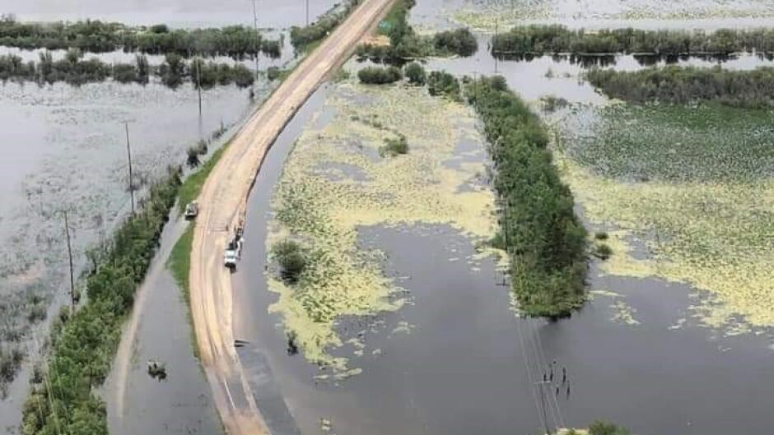
NATURAL EVENTS
Floods
Drought & wildland fires
Severe storms, including tornadoes, high winds, thunderstorms and damaging hail storms
Severe winter weather, like blizzards, and ice storms
Extreme temperatures (heat waves and extreme cold snaps)
Landslides
Storm surges
Infectious disease outbreaks

Slide 6
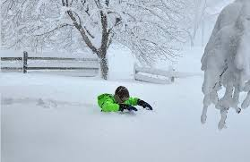
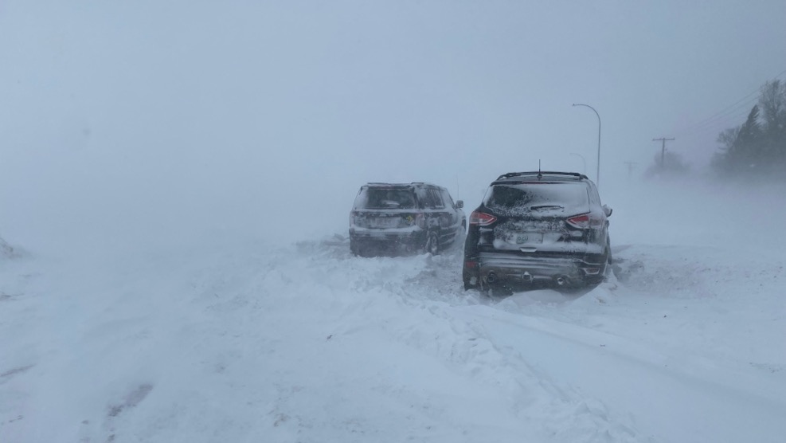

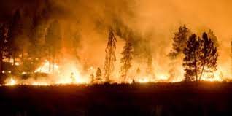
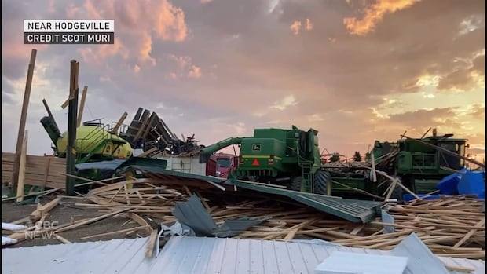

Slide 7
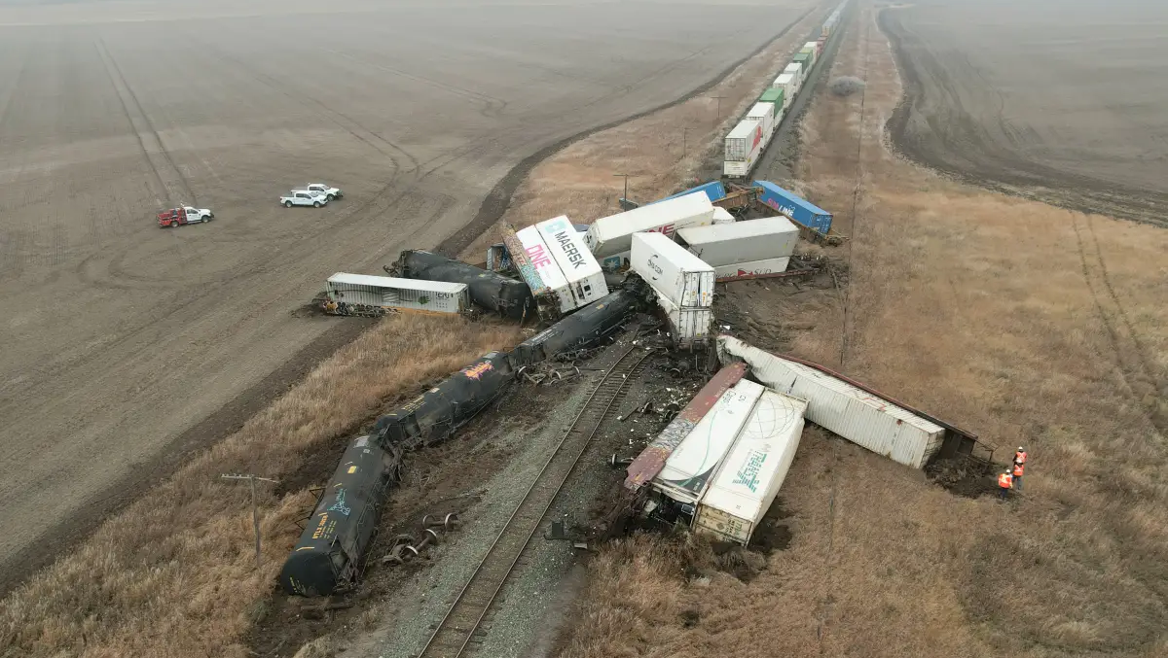
HUMAN CAUSED EMERGENCIES
Transportation accidents (road, rail & air)
Blackouts
Hazardous material spills or fumes
Explosions & structural fires
Industrial accidents
Deliberate acts, like arson, mischief, or terrorism

Slide 8
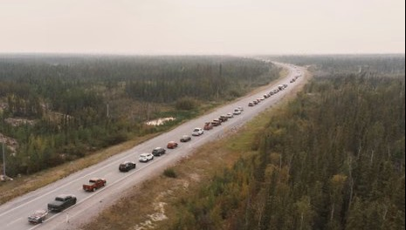
WHAT COULD HAPPEN HERE????
Severe summer thunderstorms, high winds, plow winds, hail
Tornadoes
Severe winter storms with ice, freezing rain, high winds and large accumulations of snow
Wildland fires causing widespread smoke and poor air quality
Community evacuations
Human health emergencies
Transportation incidents involving dangerous good and/or passengers

Slide 9

STEP 2: MAKE A PLAN
Every household needs a plan
A plan will help you and your family know what to do in case of an emergency
Your family may not be together when an emergency happens – plan how to meet or contact one another
Talk about what you would do in different situations

Slide 10
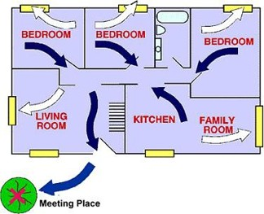
HOUSEHOLD PLAN: ESCAPE ROUTES
Plan emergency exits from each room of your home
If you live in an apartment, do not plan to use the elevators in an emergency
Identify an escape route from your neighbourhood,
in case you need to leave in a hurry.

Slide 11
HOUSEHOLD PLAN: MEETING PLACE
Choose a safe place where everyone should meet if they have to leave the house through escape routes from other rooms in an emergency
The meeting place should be on the same side of the street as your home, so you won’t have to cross the street into traffic or in front of emergency vehicles
Also identify a place to meet if you cannot go home or need to evacuate

Slide 12
CHILDREN IN EMERGENCIES
Parents should know the emergency plan of their children’s school
Know what kind of authorization is needed by the school to release children to someone other than the parent, such as a relative, trusted friend, neighbours or babysitter
Make sure your school has updated contact information for parents and other caregivers
Carry a list of important phone numbers in your school bag, or program them into your cell phone

Slide 13

PLAN FOR PETS
Remember that household pets aren’t allowed in emergency shelters and some hotels
Plan to take your pets with you to family or friends, or identify a “pet friendly” hotel or boarding kennel in advance
Put pet food and extra water in your emergency kit
Have a pet carrier for each pet
As for livestock??

Slide 14
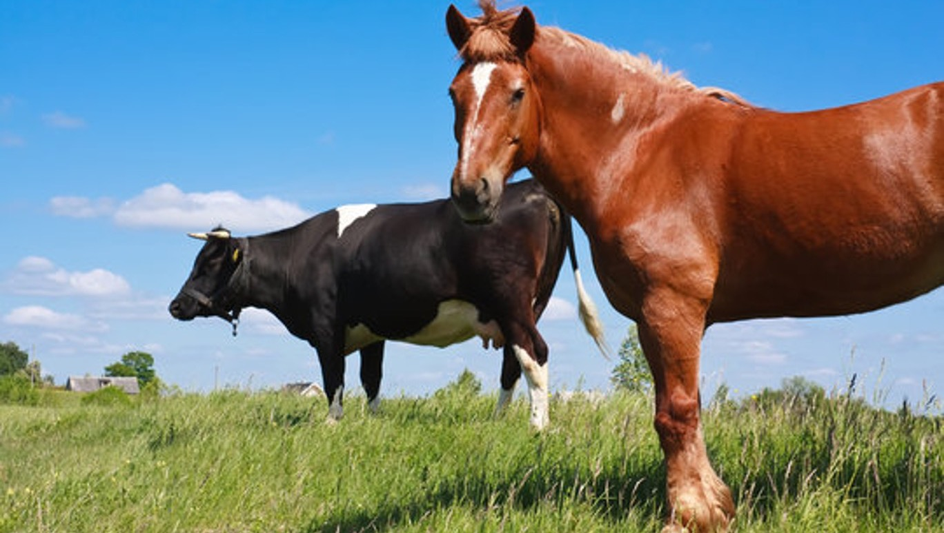
PLAN FOR LIVESTOCK
If you remain on your property during an emergency, you will need to decide whether to confine large animals in an available shelter or leave them outdoors
Ensure you have enough food and water and essential supplies for your animals for 72 hours
If you decide to evacuate you will need to make prior arrangements for a place to shelter your animals
Ensure sufficient food and water, medical supplies, temporary identification tags
Ensure you have trucks, trailers, wranglers and other vehicles for safe transport

Slide 15
PEOPLE WITH SPECIAL HEALTH NEEDS
Establish a support network of family, friends, health-care providers, co-workers and neighbours who understand your special needs
Have copies of medical history, prescriptions, health insurance, etc.
Talk to your doctor about having a “grab-and-go bag” ready with a 2 week supply of medications

Slide 16
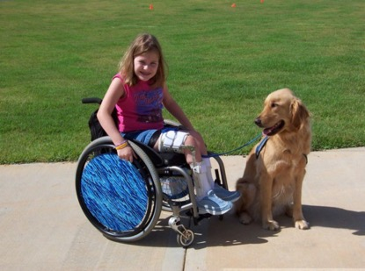
NEIBOURHOOD SAFETY PLAN
Work with your neighbours to make sure everyone is taken care of in your neighbourhood
Identify people who might need extra help in an emergency
Assign “block buddies” to check on neighbours and take care of one another

Slide 17


SAFE HOME CHECKLIST
Ensure you have your household “Quick Reference Emergency Response Plan” hanging in a prominent location and everyone knows it’s contents and what to do in the event of an emergency, review and practice it with your family
Post emergency numbers list near your phone
Make sure you have working smoke + carbon monoxide
alarms outside each sleeping area in your home
Have an ABC Rated fire extinguisher in your home, and know how to use it

Slide 18
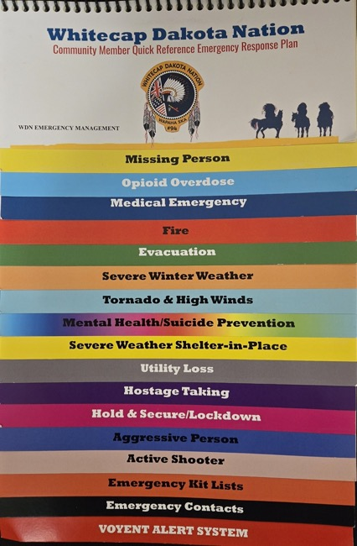
SAFE HOME CHECKLIST
Water and gas valve, electrical box – know where they are and how to shut them off
Floor drain make sure it is kept clear
Quick Reference Emergency Response Plan
on the fridge with the important numbers for family,
neighbours, doctors, vets, dentist, childcare providers,
utility companies, etc.

Slide 19
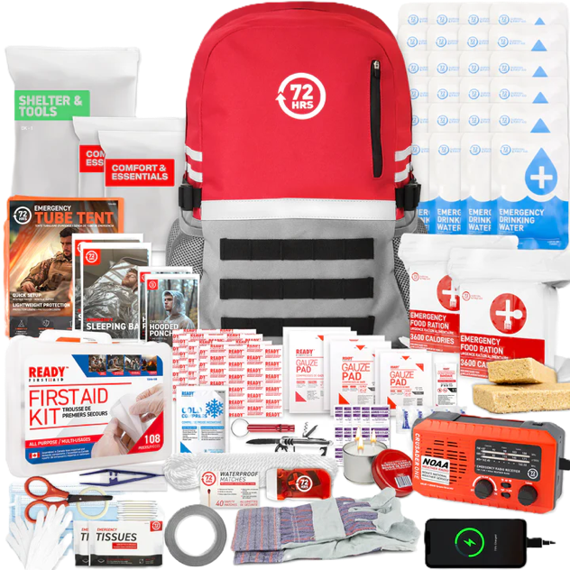
STEP: 3 GET A 72 HOUR KIT
In an emergency you will need some basic supplies. You may need to get by without power or tap water. Your household should be prepared to be self-sufficient for at least 72 hours
You can make your own 72 hour family kit,
or purchase one from:
Canadian Red Cross
72hours.ca website
totalprepare.ca website
canadiansafetysupplies.com website
Notes:
1 person kits around $150 for essentials, 4 person kits around $260 for essentials
1 person kits around $260 for deluxe and 4 person around $400.

Slide 20
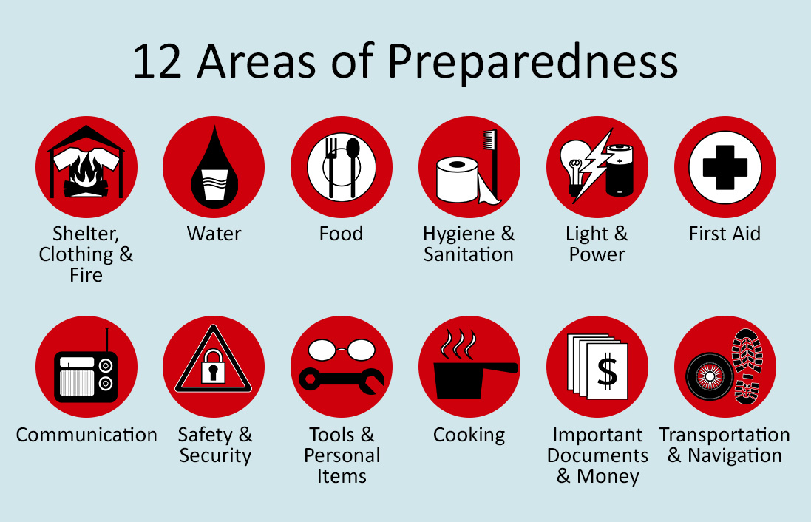

Slide 21
HOUSEHOLD 72 HOUR EMERGENCY KIT CONTENTS
Water – at least 2-4 litres of water per person per day (include small bottles that can be carried easily in case of an evacuation order)
Food that won’t spoil, such as canned food, energy bars and dried food (remember to replace the food and water at least once a year)
Manual can opener, flashlight, radio, batteries, pens, paper, candles, matches/lighter, cord, pocketknife, blankets, duct tape, solar charger, warm clothes, garbage/Ziplock bags, whistle, playing cards and child games, cooking utensils and folding stove
First aid kit (get trained in first aid & CPR)

Slide 22
EMERGENCY KIT CONTENTS
Special needs items: infant needs, prescriptions, eyeglasses or contacts
Toiletries: everything you’d use during the day
Personal documents and items: ID, passport, license, photos, cash, extra house/vehicle keys, contacts list
Additional items for winter and vehicle: salt, shovel, blankets, sleeping bags, winter boots.

Slide 23
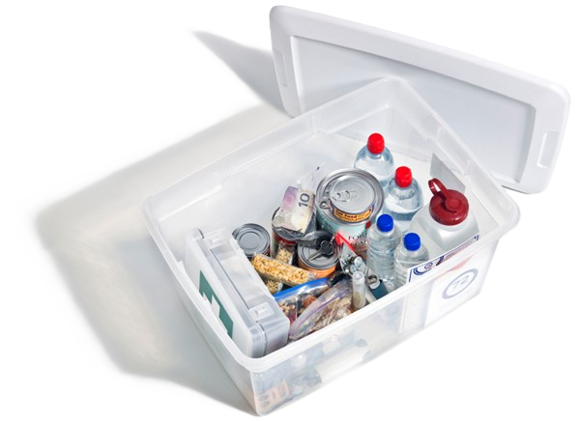
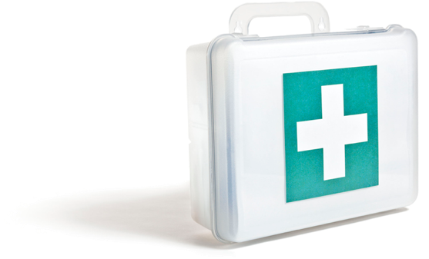
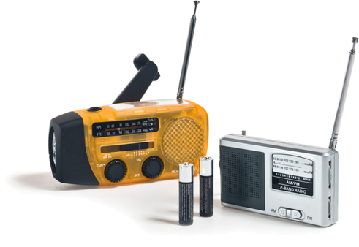
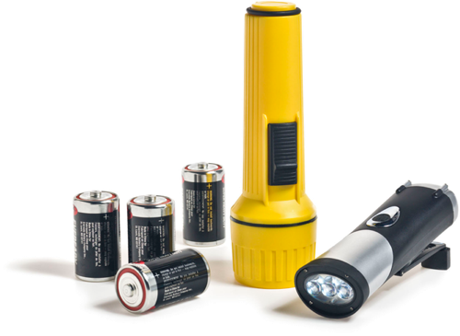



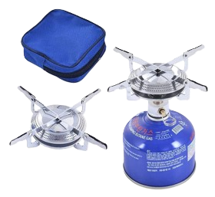
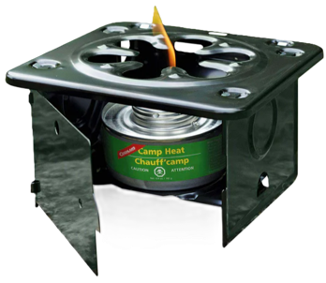

Slide 24
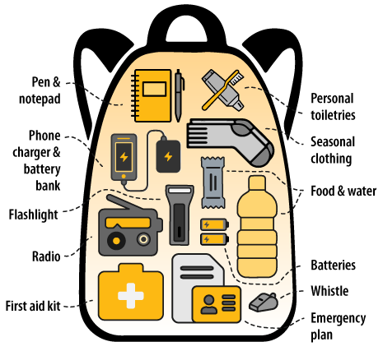
MAKE A GRAB-AND-GO BAG (For you at work, your car, and for your students at school)
Include:
Food (ready to eat) and water
Phone charger and battery bank
Small battery-powered or hand-crank radio
Battery-powered or hand-crank flashlight
Extra batteries
Small first-aid kit and personal medications
Personal toiletries and items, such as an extra pair of glasses or contact lenses
Copy of your emergency plan
Copies of important documents, such as insurance papers and identification
Cash in small bills
Local map with your family meeting place identified
Seasonal clothing and an emergency blanket
Pen and notepad
Whistle

Slide 25
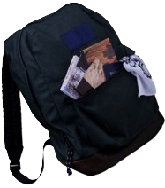
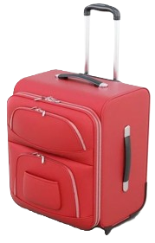
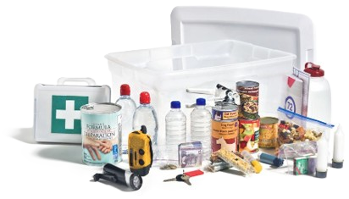
STORING YOUR KIT
Make sure your kit is easy to carry. Keep it in a backpack, duffel bag or suitcase with wheels, in an easy to reach place, such as your front hall closet
Make sure everyone in your household knows where to find the emergency kit

Slide 26



THREE STEPS TO GETTING PREPARED
STEP: 1 Know the risks
STEP: 2 Make a plan
STEP: 3 Make a family kit
YOUR 72 HOUR KIT HOLDS SUPPLIES TO SUPPORT YOU AND YOUR FAMILY FOR 3 DAYS. HAVING THE RIGHT EQUIPMENT MEANS THAT YOU AND YOUR LOVED ONES WILL BE TAKEN CARE OF AND YOU CAN SURVIVE UNTIL HELP ARRIVES.
1
3
2

Slide 27








REFERENCES & ACKNOWLEDGEMENTS
MATTHEW 25:1-13

Slide 28
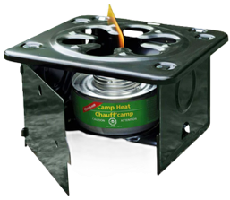
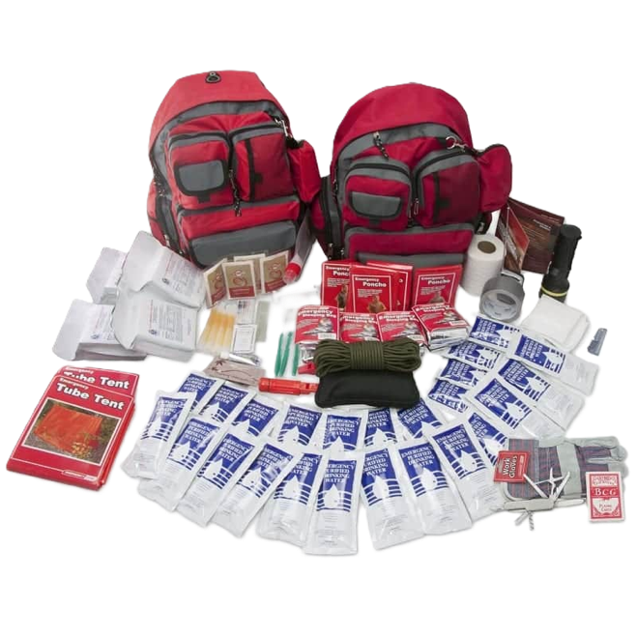
????QUESTIONS????

Slide 29
COMMUNICATIONS SUPPLIERS
Prairie Mobile (VHF/UHF Kenwood, Motorola, Tait, ICOM, Crew Connect, radios, repeaters, antenna etc.)
2622 Faithfull Ave, Saskatoon SK, 1-306-933-2667, Trevor Waring
Artisan Trucks & Equipment LTD (Motorola, Kenwood, ICOM radios, repeaters, antenna, etc.)
PO Box 194 Meath Park SK, 1-306-960-5978, Chris Conant
Timberline Radio Systems (VHF/UHF Kenwood, Tait, ICOM radios, custom built repeaters) , Vancouver BC, 1-604-290-3915, Glenn Graham
Innovation, Science and Economic Development Canada (ISED)
UHF/GMRS radios, no licence required, repeaters and high-power radios require licence

Slide 30
AVERAGE RANGE GUIDELINES
WATTAGE OUTPUT | FLAT OPEN (km) | SUBURBAN (km) | URBAN AREA (km) | INSIDE BLDGS FLOORS
FRS ½ watt | .8 – 3.2 | .8 – 2.4 | .4 – .8 | 3 – 5
1 watt (UHF) | 3.2 – 4.8 | 1.6 – 3.2 | .8 – 2.0 | 6 – 8
2 watts (UHF) | 4.8 – 6.4 | 2.4 – 4.0 | 1.6 – 2.4 | 15 – 20
2 watts (VHF) | 4.8 – 8.0 | 2.4 – 4.8 | 1.2 – 1.6 | 9 – 11
4 watts (UHF) | 6.4 – 9.6 | 4.0 – 7.2 | 2.4 – 4.8 | 25 – 30
5 watts (VHF) | 7.2 – 9.6 | 3.2 – 6.4 | 2.4 – 3.2 | 10 – 15

