Slide 1

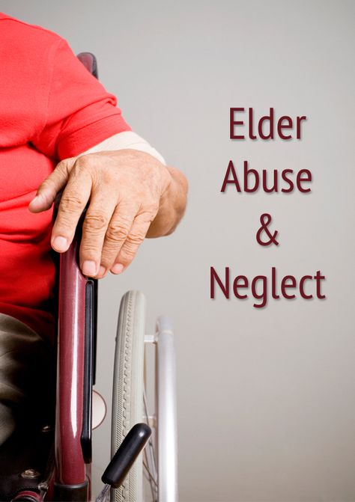


Elder/Senior Abuse
Notes:
Introduction:
Introduce yourself – Name, title, location, # of years with RCMP/previous work
Explain the objectives of this presentation – to understand elder/senior abuse, the types of abuse this demographic is most susceptible to, to know the legal consequences, how to protect yourself from it happening, how to identify signs of elder/senior abuse and how to report it
Treaty Land Acknowledgement (look up treaty area previous and read from excerpt below)
Bring to your attention that this is a serious subject and may contain some content you find disturbing
OBJECTIVES:
To educate on what elder/senior abuse is
To discuss the forms of abuse
To determine what Criminal Code Charges are associated with elder/senor abuse
To understand the risks of elder/senior abuse
To know how to protect yourself – wills, power of attorney, executor, etc.
To identify signs of elder/senior abuse and home takeovers
To know how to report
AGE GROUP: Elders/Seniors
TOTAL TIME: 45-60 minutes
------------------------------------------------------------------------------------------
For more resources and information on sexting please visit Kids Help Phone and Cybertip.ca
Resources
http://www.rcmp-grc.gc.ca/ht-tp/index-eng.htm
Healthy Relationships [www.kidsintheknow.ca]

Slide 2
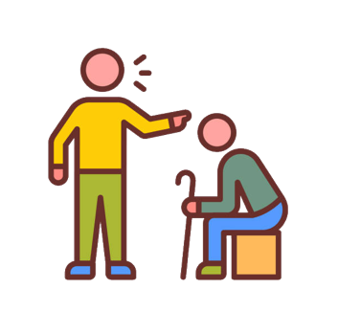
Definition of Elder/Senior Abuse:
Elder/senior abuse is the mistreatment of an older person;
It includes any intentional or reckless act or willful and negligent disregard, occurring within a relationship of family, trust or dependency, directed at someone 65 years of age or older;
It is harm done to an older person by someone in a special relationship to the older person;
The person who does the abuse may be a caregiver, a family member, a spouse, or a friend.
Notes:
Elder abuse refers to actions that harm an older person or put the person’s health/welfare at risk
This often results form the actions of someone who is trusted or relied on by the victim
------------------------------------------------------------------------------------------------------
Source:
https://www.saskhealthauthority.ca/your-health/conditions-diseases-services/healthline-online/aa60933spec

Slide 3
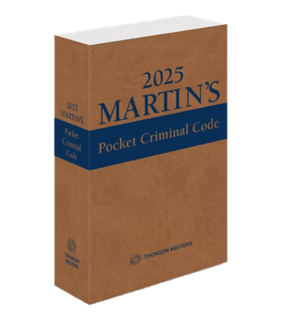
Elder Abuse in the Criminal Code
In Canada, certain forms of elder abuse are crimes under the Criminal Code.
The Criminal Code (Section 718.2) requires the court, when delivering a sentence, to take into account evidence that the offence was motivated by age or disability-based bias, prejudice or hate.
The Court must also consider whether the offender abused a position of trust or authority.
Notes:
Section 718.2 A court that imposes a sentence shall also take into consideration the following principles:
(a) a sentence should be increased or reduced to account for any relevant aggravating or mitigating circumstances relating to the offence or the offender, and, without limiting the generality of the foregoing,
(i) evidence that the offence was motivated by bias, prejudice or hate based on race, national or ethnic origin, language, colour, religion, sex, age, mental or physical disability, sexual orientation, or gender identity or expression, or on any other similar factor,
(ii) evidence that the offender, in committing the offence, abused the offender’s intimate partner or a member of the victim or the offender’s family,
(ii.1) evidence that the offender, in committing the offence, abused a person under the age of eighteen years,
(ii.2) evidence that the offender involved a person under the age of 18 years in the commission of the offence,
(iii) evidence that the offender, in committing the offence, abused a position of trust or authority in relation to the victim,
(iii.1) evidence that the offence had a significant impact on the victim, considering their age and other personal circumstances, including their health and financial situation,
(iii.2) evidence that the offence was committed against a person who, in the performance of their duties and functions, was providing health services, including personal care services,
(iv) evidence that the offence was committed for the benefit of, at the direction of or in association with a criminal organization,
(v) evidence that the offence was a terrorism offence,
(vi) evidence that the offence was committed while the offender was subject to a conditional sentence order made under section 742.1 or released on parole, statutory release or unescorted temporary absence under the Corrections and Conditional Release Act, and
(vii) evidence that the commission of the offence had the effect of impeding another person from obtaining health services, including personal care services, shall be deemed to be aggravating circumstances;
(b) a sentence should be similar to sentences imposed on similar offenders for similar offences committed in similar circumstances;
(c) where consecutive sentences are imposed, the combined sentence should not be unduly long or harsh;
(d) an offender should not be deprived of liberty, if less restrictive sanctions may be appropriate in the circumstances; and
(e) all available sanctions, other than imprisonment, that are reasonable in the circumstances and consistent with the harm done to victims or to the community should be considered for all offenders, with particular attention to the circumstances of Aboriginal offenders.
Additional consideration — increased vulnerability
Section 718.201 A court that imposes a sentence in respect of an offence that involved the abuse of an intimate partner shall consider the increased vulnerability of female persons who are victims, giving particular attention to the circumstances of Aboriginal female victims.
-------------------------------------------------------------------------------------------------------------
Source:
https://laws-lois.justice.gc.ca/eng/acts/c-46/page-121.html#h-130929

Slide 4
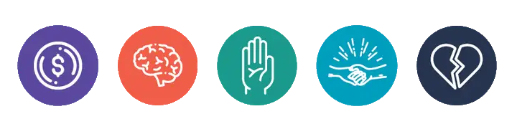
Forms of Elder Abuse
Financial
Psychological
Physical
Sexual
Neglect
Notes:
Elder Abuse is:
Financial abuse is improper use of an older person’s funds, property, or assets; this includes: stealing someone’s money/possessions, fraud, extortion, misusing a power of attorney, forging someone’s signature, or any unwanted financial activity that the person did not consent to; This is the most common type of abuse that happens to elders
Psychological (emotional/mental) abuse includes: humiliation, name-calling, intimidation/getting angry to frighten you, ignoring, or threatening to hurt you/your loved ones/your pets;
Physical abuse includes: hitting, kicking, slapping, pushing, beating, choking, burning, or forcible confinement/physical restraints (locked in a room/location against your will);
Sexual abuse includes: unwanted touching, sexual assault, or any unwanted form of sexual activity;
Neglect includes: failing to give an older person in your care food, clothing, personal shelter, medical attention, or other necessary care; it also includes abandoning an older person in your care;
-----------------------------------------------------------------------------------------------------------------------------------------
Sources:
https://www.justice.gc.ca/eng/rp-pr/cj-jp/fv-vf/elder-aines/def/p23.html
https://www.saskhealthauthority.ca/your-health/conditions-diseases-services/healthline-online/aa60933spec
https://www.justice.gc.ca/eng/rp-pr/cj-jp/fv-vf/elder-aines/def/elder_abuse-eng.pdf

Slide 5
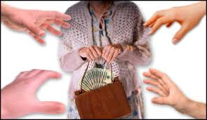
Financial abuse is improper use of an older person’s funds, property, or assets; this includes: stealing someone’s money/possessions, fraud, extortion, misusing a power of attorney, forging someone’s signature, or any unwanted financial activity that the person did not consent to; This is the most common type of abuse that happens to elders
Warning signs of financial exploitation
Sudden changes in bank accounts or banking practices, including an unexplained withdrawal of large sums of money by a person accompanying the older adult.
The inclusion of additional names on an older adult's bank signature card
Notes:
Shared Living Arrangements - Older adults living alone are much less likely to be abused. When living arrangements are shared, opportunities for the tension and conflict that usually precede abuse are greater.
-----------------------------------------------------------------------------------------
Source:
https://www.msdmanuals.com/professional/multimedia/table/risk-factors-for-elder-abuse

Slide 6
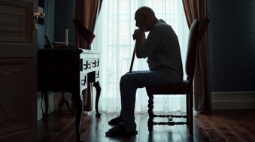
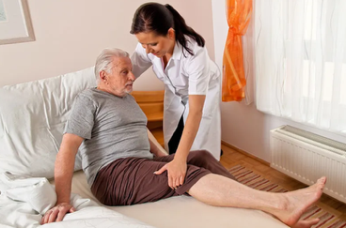

Risk Factors of Elder Abuse for the Victim:
Social isolation
Cognitive impairment
Notes:
Social isolation [enter] - Abuse of isolated people is less likely to be detected and stopped. Social isolation can intensify stress
Cognitive Impairment [enter] - Risk of financial abuse and neglect is particularly high; People with dementia may be difficult to care for, frustrating caregivers, and may be aggressive and disruptive, precipitating abuse by overwhelmed caregivers.
----------------------------------------------------------------------------------------
Source:
https://www.msdmanuals.com/professional/multimedia/table/risk-factors-for-elder-abuse

Slide 7

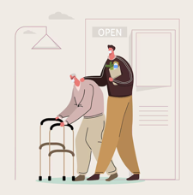

Risk Factors of Elder Abuse for the Perpetrator:
Prescription Drugs
History of Violence
Dependence of the Perpetrator on the Older Person
Stress
Notes:
Substance Abuse [enter] - Alcohol or drug use disorders, intoxication, and substance withdrawal are the leading predictors of abusive behavior. Substance-dependent caregivers may attempt to use or sell drugs prescribed to the older adult, depriving the elder of their treatment.
History of Violence [enter] - A history of violence in a relationship (particularly between spouses) and outside the family may predict elder abuse. One theory is that violence is a learned response to difficult life experiences and a learned method of expressing anger and frustration. Because reliable information about past family violence is difficult to obtain, this theory is unsubstantiated.
Dependence on Perpetrator on the older person [enter] - Dependence on the older adult for financial support, medical or functional assistance, housing, emotional support, and other needs can cause resentment, contributing to abuse. If the older adult refuses to provide resources to a family member (especially an adult child), abuse is more likely.
Stress [enter] -
--------------------------------------------------------------------------------
Source:
https://www.msdmanuals.com/professional/multimedia/table/risk-factors-for-elder-abuse

Slide 8

Risk Factors of Elder Abuse for Both the Victim & Perpetrator:
Shared Living Arrangements
Notes:
Shared Living Arrangements - Older adults living alone are much less likely to be abused. When living arrangements are shared, opportunities for the tension and conflict that usually precede abuse are greater.
-----------------------------------------------------------------------------------------
Source:
https://www.msdmanuals.com/professional/multimedia/table/risk-factors-for-elder-abuse

Slide 9
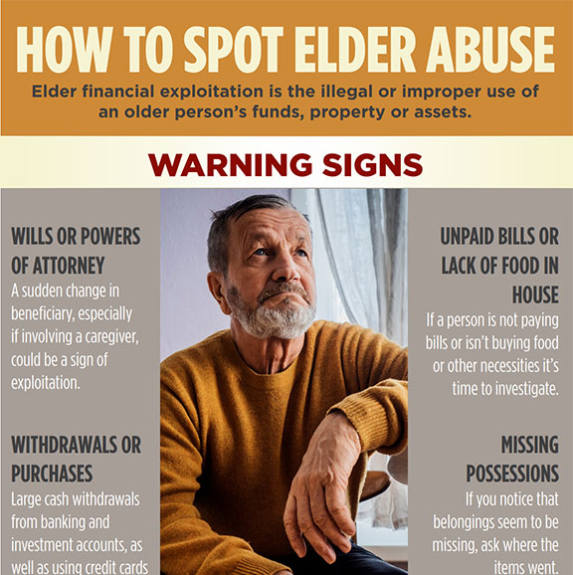
What are the red flags of elder abuse?
Unexplained injuries or physical signs of punishment or restraint, such as bruises, scars, or burns. Emotional. Depression, anxiety, or changes in behavior

Slide 10
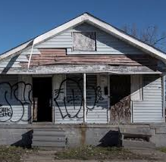
Home Takeover:
Gang-related activities – child/grandchild is part of a gang and kicks out grandparent creating a (trap house) in the community

Slide 11
How to Protect Yourself:
Wills, Programs & Services
Power of Attorney/Funeral Planning
Estate Settlement/Inheritance – Executor/Beneficiaries
Notes:
Will – create a will ASAP
Power of Attorney – decide who will be your power of attorney in the case something happens
Estate Settlement/Inheritance/Executor/Beneficiaries – determine who will play the role for each of these ASAP and put them in your will

Slide 12

Will
Also know as “last will and testament”
Legal document
Outlining a person’s assets and belongings on how to be distributed after their death
Individuals to specify their wishes regarding inheritance / provisions for care of any dependents
In SK, it must be in writing signed by the testator (person making the will) and witnessed by two adults not named in the will
Notes:
A will is important because if you don’t have one all your money goes back to the GOVT

Slide 13
Power of Attorney (POA)
Allows an individual to appoint someone to make decisions on their behalf while they are still alive
Executor
Purpose – is named in a Will to manage the affairs of a deceased person’s estate after their death;
Notes:
It’s very hard to overturn the Power of Attorney once the decision is made.
POA grants the agent the authority to handle various matters such as financial decisions, property management, health care decisions and more as specified in the document
POA is typically effective from the moment it is signed and can continue indefinitely unless revoked by the principal or upon their death
Function – the Executor’s responsibilities include gathering assets, paying debts and taxes, resolving claims against the estate, and distributing assets to beneficiaries as specified in the Will;
Duration – the Executor’s role is activated upon the person’s death and continues until the estate is settled;
Authority – the Executor’s actions are guided by the deceased person’s Will and applicable laws.
An EXECUTOR must ensure that:
All beneficiaries are treated fairly and equitably, and receive proper information and reporting
Assets are identified, located, and protected;
Debts, liabilities, and taxes are discovered and paid;
Investments, real estate holdings, creditors, and business interests are properly managed and overseen;
Estate assets are distributed to the correct beneficiaries in accordance with the terms of the Will and any applicable legislation.

Slide 14
Beneficiary:
Role – receives assets from the estate as outlined in the Will;
Responsibilities – none in terms of estate administration;
Compensation – receives the assets distributed from the estate.

Slide 15
Reporting:
Tell someone – tell someone you trust
Contact local law enforcement – RCMP or municipal
Crime Stoppers – anonymous reporting & up to $2k for helpful tip that leads to a charge
Housing Authority – contact local housing authority and let them know
Home Care – if happening in a care home, report to administrative staff
Notes:
When reporting to police, understand that a full investigation will need to take place. They will ask many personal questions and get a statement as part of their investigation.

Slide 16
Illegal Drugs
Controlled Drugs and Substances Act
Any substance that contains a controlled substance, including synthetic or natural forms, that contains or has on it a controlled substance and is used, intended or designed for use in producing the substance or introducing the substance into a human body

Slide 17
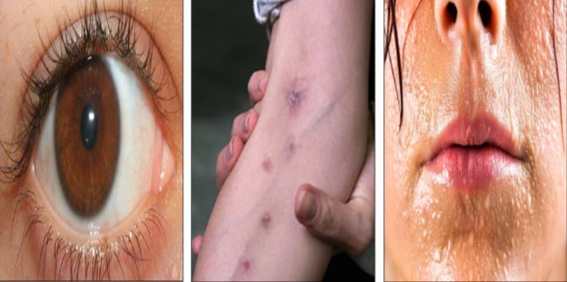
Depressants / Downers
Side effects: Apathy, drowsiness, slow movements, lack of concentration, dizziness, depression, anxiety, decreased breathing, slurred speech, blurred vision, decreased libido, loss of appetite, constipation
Signs of Overdose: Decreased heart rate, slow breathing, clammy, cold
and bluish skin, deep sleep, stupor, coma, death by respiratory depression

Slide 18
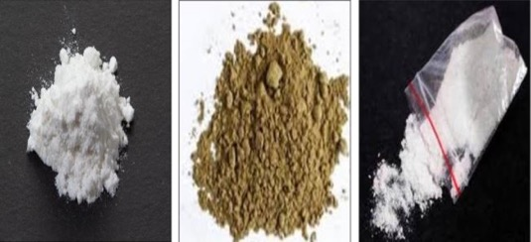
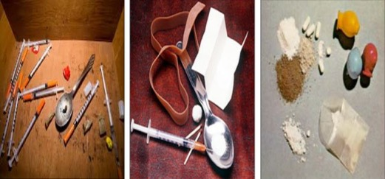
Heroin
Common names: Smack, H, China White
Consumption: Powder is smoked/inhaled and injected
Notes:
Heroin is an illegal highly addictive opioid drug
Also known as a central nervous system depressant because it slows down the activity of the brain and nervous system
Drowsiness and sedation – relaxed state
Can cause clouded mental function, confusion and difficulty concentrating
Breathing and heart rate are slowed down
Injections = straight into the vein
Snorting = the powder is inhaled through the nose
Smoking =

Slide 19
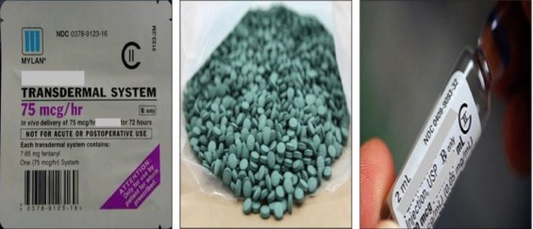
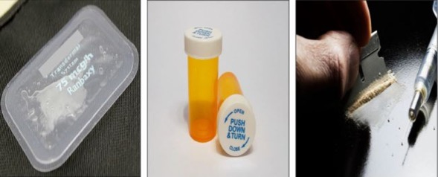
Fentanyl
Common names: China White, Synthetic Heroin, Patch, Sticker
Consumption: Tablets are ingested, smoked/inhaled and injected, patches are topic
Notes:
Powerful syntenic opioid
Illegal
Made in the lab
Often mixed with other street drugs like heroin, cocaine and meth
It is impossible to see, smell or taste

Slide 20
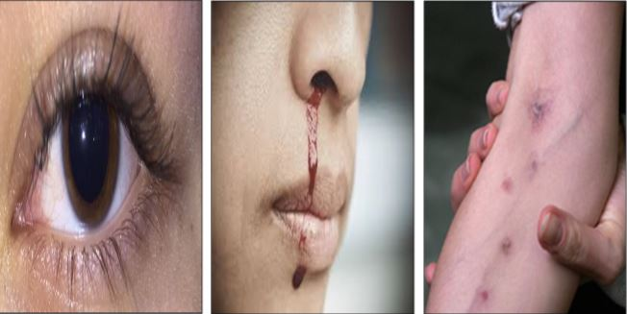
Stimulants / Uppers
Side effects: Anxiety, irritability, impaired judgment, increased heart rate and
body temperature, tactile hallucinations, reduced appetite, aggressive thoughts,
anger, paranoia, insomnia
Signs of Overdose: Chest pain, arrhythmia, confusion, convulsions, respiratory
depression, coma, death

Slide 21
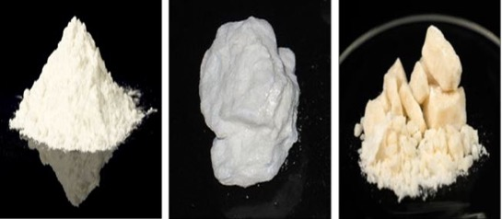
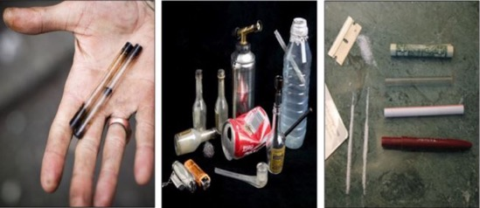
Cocaine
Common names: Coke, Powder, Snow, Crack, Rock, Freebase
Consumption: Shiny crystalline powder that is injected or snorted and little rocks that are smoked/inhaled
Notes:
Powerful addictive stimulant drug
Dopamine increase = intense feeling that fades quickly and promotes users to want more and more
Increase heart rates, body temperature and blood pressure
FORMS
Powereded cocaine
Usually snorted through the nose
Crack Cocaine
Can be made with cocaine, baking soda and water to create a rock crystal that is smoked
Intense high but very brief

Slide 22
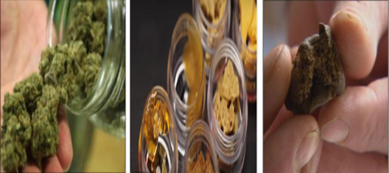
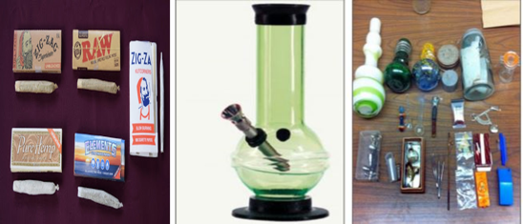
Common names: Pot, Weed, Marijuana, Marijane, Grass, Green
Consumption: Leaves and dried leaves (bud) that are smoked/inhaled, ingested
Cannabis

Slide 23
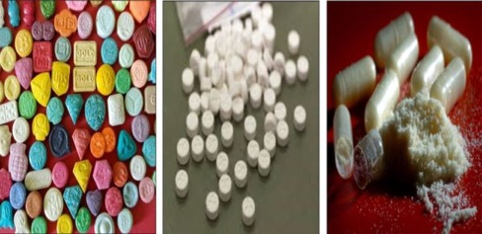
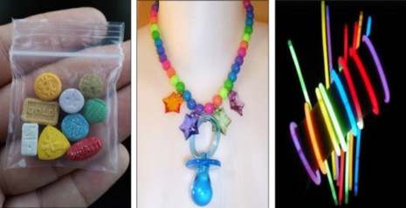
MDMA
Common names: Ecstasy, E, Molly, Party Pill, Speed
Consumption: Tablets or crystalline powder are ingested
Notes:
Also known as a “Club Drug”
Recreational drug
Most likely taken at music festivals and night clubs

Slide 24
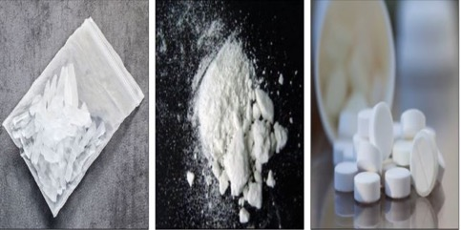
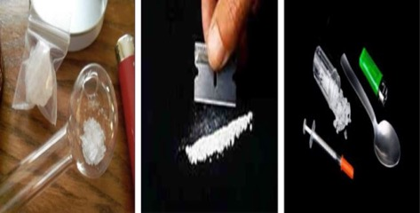
Methamphetamine
Common names: Crystal meth, Meth, Speed, Glass, Cristal
Consumption: Tablets are ingested, powder is smoked/inhaled, injected, and snorted, transparent crystals are smoked/inhaled/injected
Notes:
What is Crystal Meth
Crystal Substance or broken glass
Your attention is focused
Makes you feel alive / a lot of energy
Cheapest drug you can buy
$2-3 dollars in the city and in the communities it goes up about $5 a point
Someone who smokes meth can be up for days at a time – 3-5 days
Staying up for days
The ability to keep the body up for days at a time
When the effects of the drug wears off or when the body can’t handle the drug anymore it will experience a crash
The user may sleep for days on end
Ingredients
Over the counter purchases
Battery acid
Nail polish remover
Drano
Chemicals
Signs for someone on Crystal Meth
Sores
On their face and arms / causes them to pick their skin resulting in red irritation and bumps that appear on their body
Tweaking
End of the binge
When they cant get high they get extremely agitated
A sensation of bugs crawling on them
No sleep
Growing paranoid
Delusional thinking and irrational behaviour
Paranoia or hallucinations
Obsessed with their surroundings
Believe that someone is watching them or trying to hurt them
Extreme Weight Loss
Like most stimulant drugs meth is an appetite suppressant
They will have no appetite, their body is in over drive which forces the body into starvation mode causing a person to experience rapid weight loss
Meth
- Stinks like dirty n

Slide 25
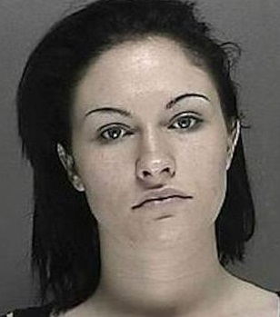
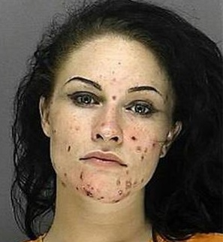
Before & After Using Crystal Meth
Notes:
Sores
On their face / arms
Causing them to pick at their skin

Slide 26
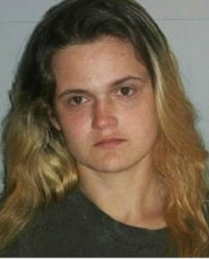
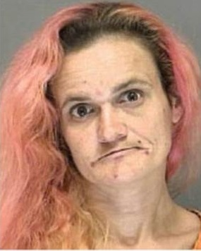
Before & After Using Crystal Meth
11 years

Slide 27
Warning Signs of Drug Use
At Home
Changes in sleeping and eating patterns
Changes in physical appearance (e.g. hygiene, weight and skin)
Presence of strange odours
Increased use of strong cologne, mouth wash, eye drops
Changes in emotions and behaviour
Difficulty following instructions or concentrating
Avoiding eye contact
Excessive secrecy or guarded behaviour
Possession of drug paraphernalia
Over-the-counter drugs disappearing from the medicine cabinet

Slide 28

Warning Signs of Drug Use
In Community
Changes in schools and/or work performance
Loss of interest in usual hobbies and activities
Change of friends
Defending a known drug user
Requesting money
Increased amounts of unaccountable money of their own
Receiving expensive gifts from friends

Slide 29
Ways to Respond
Report Crime
911 for life and death emergencies – Dial 9-1-1
RCMP for non-emergencies – Dial 310-RCMP
Crime Stoppers to give anonymous crime tips – 1-800-222-TIPS
Use Help Lines
211 Saskatchewan Help Line – Dial 2-1-1
Canada Suicide Prevention Service – 1-833-456-4566
Canadian Indian Residential Schools Crisis Line – 1-866-925-4419
Crisis Text Line (youth) – Text CONNECT to 686868
First Nations and Inuit Hope for Wellness 1-855-242-3310
Kids Help Phone (under 21) – 1-800-668-6868
Trans Lifeline – 1-877-330-6366

Slide 30
Questions:

