Slide 1

RezCross
Operation Red Willow
Loressa Mike
Emergency Management Coordinator
Beardy’s & Okemasis’ Cree nation

Slide 2
What is RezCross?
an Indigenous led Emergency Evacuation Center, first of its kind
providing holistic, culturally grounded care for our northern relations fleeing the north
indigenous-led emergency response and supports
supported by compassionate community members who understand the unique realities faced by our first nation relatives
safe, welcoming space with a proud legacy

Slide 3
Assembling our Team
Our Story

Slide 4
“Our community has always lent a helping hand when called to do so… and our community has always been a gathering place for folks coming to our territories. We are known in Cree as wastahimakiw iyiniwak – ‘the waving people’ because of our good nature, and our hospitality. We’re going to continue that by opening RezCross again for our relations fleeing the devastating wildfires in Northern Saskatchewan. Our people demonstrated that compassion and care 10 years ago, and we’re doing it again now.”
- Melanie Gardypie
Councilor i/c Emergency Management

Slide 5
Elements of Support
Accommodations
Nutrition
Health Services
Mental Health
Recreation
Safety

Slide 6
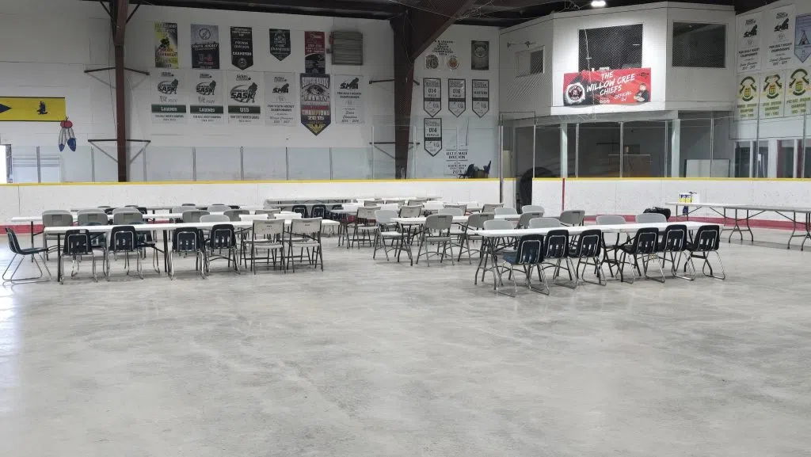
Accommodations
congregated sleeping arrangement
queen air mattress beds
cribs and playpens
accessible beds for elderly
male and female bathroom facilities with showers

Slide 7
Nutrition
Three hot and fresh meals offered every day for the duration of our stay
All dietary needs were met
Culturally based meals
Accessible snacks for all ages
Fresh water, coffee and tea
All baby formula was gathered for those that needed it

Slide 8
Health Services
Home Care
Primary Health
Nursing staff
Dental
Medical Transportation
Diet and Nutrition

Slide 9
Mental Health
Offered 24/7 on site supports
  Counselling and Therapy
  IRS support
  Addictions
  Cultural and Spiritual supports
  Elder supports
  Our supports were available to our visitors when ever they were needed

Slide 10
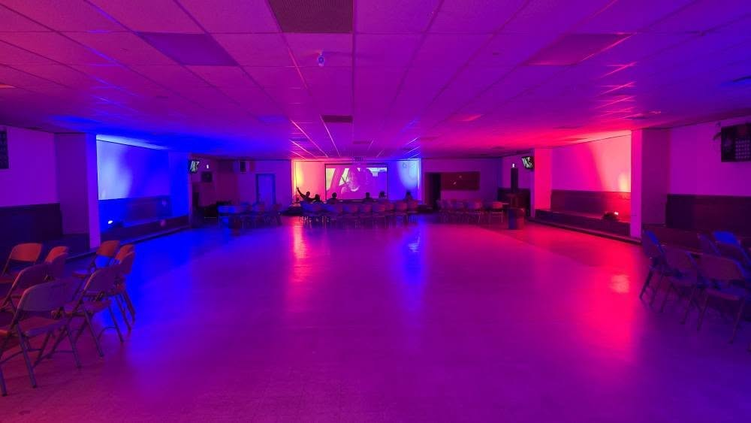
Recreational Activities
Gym nights
Oilers watch party
BINGO shuttles
Movie theatre trips
Petting zoo
Bouncy castle
Wagon rides

Slide 11
Safety
Our site was staffed 24/7 with security to keep our northern relatives safe and secure during their stay
Our team did a call out for trained security guards in the community, our membership answered that call.
RCMP Patrolling the main road leading to our center.

Slide 12
Our Team
Site Coordinator
Security Coordinator
Volunteer Coordinator
Transportation Coordinator
Cooks
Security workers
Drivers
Volunteers
Medical transport drivers
Nurses
Mental Health staff
Addictions Staff
Home Care
On Site Elders
Finance

Slide 13
Special Thanks:
Saskatchewan Wildland Firefighters
International Wildland Firefighters
Evacuation Coordinators
Evacuation Center support workers and volunteers
Beardy’s & Okemasis’ Cree Nation Chief and Council
Beardy’s & Okemasis’ Cree Nation Departments:
Willow Cree Health, Community Development, Prevention, Sports, Youth, Culture and Recreation, The Grill Staff, Finance, Lands, QBOW, Justice-
All those that donated to our endeavor
All our Northern Brothers and Sisters who entrusted our nation with their families

Slide 14
QUESTIONS?

