Slide 1
Emergency Management Assistance Program (EMAP)
Saskatchewan First Nations Emergency Management Forum
October 2025

Slide 2
About the Program
In partnership with First Nations communities, provincial governments and non-government organizations, EMAP provides access to emergency assistance services to protect the health and safety of First Nation communities and individuals, property, infrastructure, and the environment.
EMAP provides funding to First Nations communities to support building emergency management capacity to prepare, mitigate, respond, and recover from natural hazards.
EMAP aims to be flexible, culturally sensitive, responsive to the unique strengths and customs of First Nations communities, and adaptive to the evolving challenges resulting from emergency events.
First Nation led approach.
Collaboration
First Nation
Provincial
NGO
Federal

Slide 3




The Four Pillars of Emergency Management
The 4 Pillars of Emergency Management
Funding Streams
MITIGATION
PREPAREDNESS
Non-Structural Mitigation and Preparedness – Low-Value Equipment
FireSmart
Capacity Enhancement
Activities and practices designed to mitigate or minimize impacts of an emergency
Planning and readiness measures to enable effective response to and recovery from an emergency
RESPONSE
RECOVERY
Response & Recovery
Search & Recovery
Health Emergency Management
Activities taken immediately before, during, or after an emergency to address the short-term effects and reduce loss and suffering
Activities to restore physical, social and economic activities to pre-event levels or better

Slide 4
Capacity Development and Non-Structural Mitigation and Preparedness (NSMP)
Capacity Development – support to build emergency management capacity at the First Nation and Tribal Council level.
NSMP – support to build/enhance a coordinated approach to emergency management in First Nation communities to effectively manage emergency situations
Proposal Driven (multi-year - FLEX)
establish community emergency management lead and team
Develop/update all-hazard emergency management plans reflective of the hazards and risks (risk assessments) as well as response and recovery processes
engage with membership to enhance community preparedness, response, and recovery
determine emergency management training needs – ICS, EOC, ESS, S&R, 1st Responder
Search and Recovery
FireSmart – Preparedness initiatives to FireSmart communities to address the threat of
wildland fire and mitigation measures – education, emergency planning, training, fire
assessments, fuel management.

Slide 5
Response and Recovery Program
The objective is to:
Minimize the impacts of emergencies on First Nations including evacuations;
Return First Nations to their communities as quickly as is safe to do so;
Build back better community infrastructure to enhance community resilience
reimburse eligible response and recovery activities, helping the community recover in a timely manner
Process to engage EMAP assistance:
72 Hours – First Nation internal capacity response – manage and coordinate
First Nation internal capacity becomes overwhelmed – engage outside resources – neighboring First Nations, Tribal Council, Province, CRC, other
Conversation/discussion – insurance, First Nation response, damages
Take photos and document all response activities including costs
Cost recovery
Eligible, actual expenditures of emergency management response/recovery (invoices, timesheets, payment)
provision of advances (%) based on estimates

Slide 6




Emergency Management Eligibility Overview
Eligible emergency events are natural disasters impacting First Nation residents on reserve which may include
Extreme Cold
Extreme Heat
Extreme Wind
Grassfire
Loss of Essential Services
Overland Flooding Events
Extreme Weather
Wildfire
EMAP support is available when an event exceeds the financial capacity of the Nation to address.
Eligible Aspects of a Health Emergency
Communicable Diseases Outbreaks
Food and water contamination
Environmental health hazards
Mental wellness emergencies
Notes:
Eligibility is established in the Terms & Conditions
Eligibility is based on:
The program continues to evolve an all hazards approach to better serve the needs of communities in a sustainable way
EMAP is intended to be a funding mechanism of last resort
Eligibility of Events
This list represents some of the most common events supported in the past. If emergency impacts your Nation, please let your AEMA Field Officer know and ISC will provide feedback on the eligibility of funding for your unique situation.
Please continue to reach out as events come up so that ISC can and will continue to refine the program as Nations identify their needs.
This is not a limiting list, these are just examples of events we have seen and supported within Alberta Region.
For an event to meet the requirements of “Natural Disaster”, the event cannot have been caused by human means. As a result, emergencies such as structural fires and events related responding to collisions are generally outside of the EMAP funding eligibility.
Demonstrating exceeding of Capacity
For the costs of an event to be eligible for funding from the EMAP, the emergency event must be of such proportions or nature as to exceed the capacity, including financial capacity, or authority of a First Nation to address it.
Some examples of demonstrating that the event exceeds the financial capacity are confirmation the event impacts more than two homes, families, or pieces of infrastructure.
Terms and Conditions
As of April 1, 2022 the EMAP terms and conditions also support activities related to health emergencies or the health aspects of emergencies caused by natural or accidental hazards, including disaster-related mental health impacts, and treatment and primary care needs during emergency events.
Health Emergencies
Health Aspects caused by disasters: (such as risks related to the continuity of health care for those with existing medical conditions; or the public health and mental wellness impacts of community evacuations and emergencies)“
Communicable disease outbreaks (measles, syphilis, etc.);
Food and water contamination;
Environmental health hazards (mold, air quality, radioactive fallout, etc.);
Mental wellness emergencies;
Suicide clusters requiring additional crisis response; or,
Health aspects of emergencies or disasters caused by natural or accidental hazards.
Once ISC is notified of an event, the Emergency Management Advisor assigned to the event will work to understand the impacts of the event and needs of the Nation for consideration of funding through the program.

Slide 7
Response Supports
Emergency Response supports include:
Operations
Activities such as wildland firefighting, fuel clearing/mulching, pumping of flood water, etc.
Social
short term supports to ensure health, safety and well-being of evacuees
Temporary Evacuation and Displacement
support for evacuations, including long term evacuations more than 60 days
Search and Recovery
support efforts to recover an individual(s) when first response is not successful
Emergency Transportation and Repatriation
support for emergency transportation and repatriation expenses

Slide 8
Recovery Supports (Build Back Better)
Recovery supports include:
Permanent Repair of Damaged (Uninsured) Infrastructure
Repair/Return damaged community infrastructure to pre-disaster condition.
Mitigation Measures
structural design enhancements toward physical resiliency and protection against future events
Personal Losses
recovery of personal property lost during emergency
Long Term Evacuations
costs associated with evacuations longer than 60 days

Slide 9
Eligibility (FAA, Special Allotment)
Eligible costs incurred during a disaster/emergency event on reserve, where the impacts are beyond the First Nation’s capacity to respond.
The general process for reimbursement:
community responds to the event, incur costs, and then submit a claims package to ISC Regional EM with supporting documentation (invoices, paystubs, receipts, etc.) for reimbursement.
“approval in principle” from ISC Regional EM for emergency response or recovery approach/anticipated expenses, verifying that they will later be eligible for reimbursement
communities can request confirmation that their expenses related to an imminent threat response will be reimbursed.
“advanced payment” from ISC to promptly respond to the event and address cash flow requirements.
In all cases, required documentation must be submitted (see Annexes) to ISC and reviewed to ensure that payments are based on actual invoices as per the EMAP’s Terms and Conditions and that emergency activities are eligible before the full requested funding can be transferred.
It is important to engage your ISC Emergency Management Officer at the onset of the emergency event to provide awareness of community response and impacts and obtain guidance on EMAP eligibility for response and recovery.

Slide 10

EMAP Application Tips
4. Understanding active vs. imminent threat
Active threat: An event that is happening in real time.
Imminent threat: An event that has a high probability of occurring in the near future.
Nations do not have to wait for an event to start to begin the process of response activities
Activities that can be used to prepare are eligible under EMAP following pre-approval
Preparation activities for an imminent threat must be pre-approved to be eligible for EMAP reimbursement.

Slide 11
Reimbursement
EMAP is a reimbursement program that requires detailed documentation be submitted for reimbursement.
Documentation required includes:
Invoices
Proof of payment
Electronic Fund Transfer Confirmation
Payroll
Time Sheets
Inspection Report from Adjuster (for damaged infrastructure)
This includes approval in principle activities, per diem meals, content loss, and proof of payment of funds to members is required after funding has flowed to the Nation.
Notes:
In addition to costs supported by damage assessments, funding is available for other response activities undertaken by the Nation during an eligible event. These have some general documentation requirements as noted in the slide.
Submitting the Claim
The EMAP Claim should include a spreadsheet of costs and how they relate to the disaster event as well as supporting documentation to substantiate the claim including invoices, proof of payments such as cheque stubs, payroll, general ledger, electronic fund transfer Confirmation etc.
Submission of the required documentation may be difficult due to the limitations of size of emails that can be accepted by the AB Emergency mailbox. There are a few options for submitting the required documentation.
Review and Payment
The assigned EM Advisor will review the claim; identifying eligible and ineligible costs and creates a summary which constitutes payment recommendation as well as review against any approvals in principle.
The EM advisor will work with you throughout this to discuss the eligibility of costs and request any additional information required.
Throughout the submission process, funding may be provided upon request for eligible costs incurred and fully supported based on EMAP's requirement prior to completion of submission or in advance based on case-by-case pre-approved requests.
As emergency events are not included in our annual budget, additional time is required from HQ to receive the appropriate funding
We understand the stress that emergency events cause, and we are working with you to support your Nation, however this can be contingent on claims including complete document submission, coordination between the Nation and the EM advisors throughout the review of the claims and documents.
Closing a claim
Once the review is complete and the Nation has confirmed no further documentation will be submitted for the event, a letter will be provided to the Nation summarizing the reimbursement for the event

Slide 12
The Claim – what is required?
Community Coordination
EOC operation
Shelter-in-place
Additional health supports
Evacuation
List of Evacuees
Duration of evacuation
Hotel invoices
Meal receipts
Transportation
Activity costs within Host Community
Contracted Services
Incremental Overtime for Support Services
Emergency Operation Costs (Including operational support from neighboring communities)
Quote & Invoice for work from supporting community
Invoices for any equipment rentals
Proof of payment
For heavy equipment operation reimbursement, EMAP utilizes provincial rates for reimbursement. We would need to know what equipment you are operating.

Slide 13
The Claim – what is required?
Home Damages & Content Loss (for uninsured homes)
Home inspection report from a Level 3 adjuster which includes:
Photos of damages resulting from disaster event
List of required repairs & their costs
Confirmation damages are direct result of disaster event
List of recommended mitigation measures & their costs
Once repairs are complete, proof of payment for work done (aligned with inspection/adjuster report) will be submitted.
For content loss we reimburse based on the Schedule of Personal Losses
Staffing (Band staff OT & Casual staff wages)
Time sheets for both band staff overtime & casual staff hours.
Confirmation of casual staff
Proof of payment

Slide 14

Damage Assessment Report Requirements
The damage inspection report must be from a third party, adjuster and include:
Confirmation that the damage is from the disaster event.
What items/services/repairs are needed to bring the unit or home back to pre-event condition
Cost estimates for repair structure back to pre-event condition
Possible mitigation measures for event(s) that caused damages
Photos of the damaged areas of the home from the time of the event (First Nation, adjuster)
A listing of insured vs. non-insured houses

Slide 15
EMAP Application Tips
1. Complete a damage assessment prior to the completion of permanent repairs to infrastructure.
A damage assessment is required ideally within 60 days of when it is safe to return to community
The cost for a damage assessment is reimbursable and is recommended to be completed by a qualified professional such as an adjuster or an engineering firm
The benefit of contracting a professional to complete the damage assessment is if they suggest there is a way to rebuild better for resiliency, it is eligible under Build Back Better funding
2. Keep track and submit all documents
In order to receive reimbursements, accompanying invoices and proof of payment for all costs expended must be submitted
Reimbursements are based on actuals, not general ledgers.
3. If you are unsure about the EMAP eligibility of a cost incurred during an emergency disaster event, contact the EMAP team.
Notes:
*proof of payment methods needed

Slide 16

Common Application Gaps: Payment Options
Partial EMAP Claim Submissions
If an event is active for a long period of time, you do not have to wait until the event is declared to be over to submit a claim for reimbursement
Nations can submit invoices and proof of payments for advances
2. Advance Payments/Immediate Needs
Additional options for advance payments based on estimates can be considered if it is a large-scale/long-term event
All costs must be later substantiated with all required documentation.
3. Outstanding Costs
If Nations have outstanding costs they may have not submitted from previous years, they can collect and send for reimbursement at any time as long as all required documentation is submitted

Slide 17

Tracking Costs
The EMAP Claim should include a spreadsheet of costs and how they relate to the disaster event as well as supporting documentation to substantiate the claim including invoices, proof of payments such as cheque stubs, payroll, electronic fund transfer confirmation etc.

Slide 18
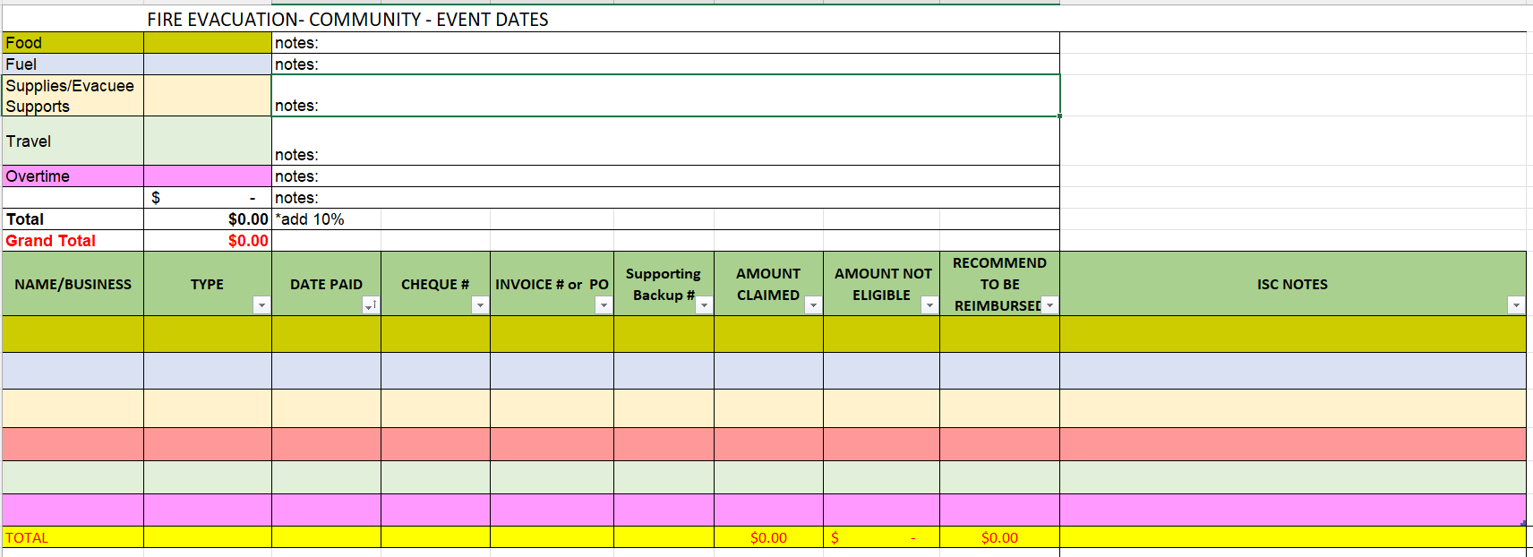

Slide 19


The Event – what happened?
ISC SK Region EM received from the First Nation the following information for an emergency event that impacted the community with the following details:
“ISC SK Region received notification at 21:25 hours of a wildfire on the southeast end of the XYZ First Nation. As of 23:00 hours the wildfire is approximately 700 hectares.
Evacuation of approximately 50 homes was conducted through the evening, all evacuees registered at the local multiplex and then went to hotels in the nearest town.
XYZ Nation’s fire department, with support from two neighboring First Nation wildland fire crews, are setting up sprinkler protection units on impacted and threatened homes in the SE end of the Nation.
XYZ Nation’s fire department also has a dozer crew on location working to create fireguards where needed. Air suppression is starting in the morning with helicopters and water bombers.”
The event lasted a week and the damages that occurred to the Nations homes will require repairs before the residents can safely repatriate. The roofs and exteriors of 7 homes experienced water damage and content damage/loss as a result of the sprinkler systems that were set up.

Slide 20
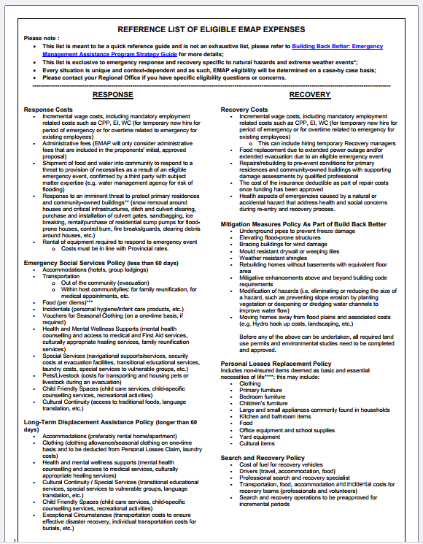
DEVELOPMENT OF EMAP GUIDANCE/TOOLS
EMAP Eligibility
Personal Loss
Security Guidelines
Search and Recovery Guidelines
Guidelines for Rental/Acquisition of Air Purifiers in Homes
Guidelines for Rental/Acquisition of Air Conditioners in Homes
Policy Guideline for Traditional Foods
Health Response

Slide 21
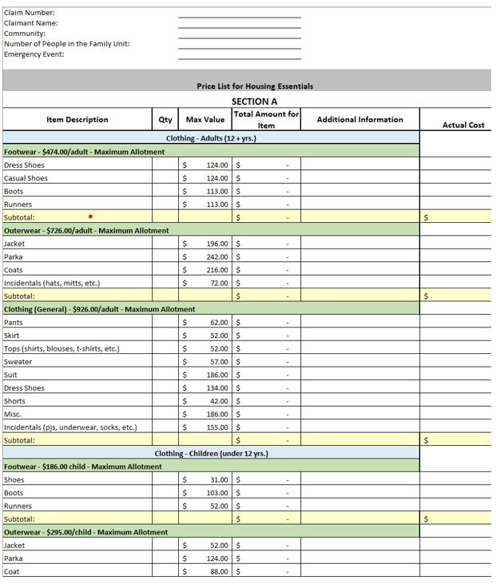
Personal Loss – Loss/Housing Damage

Slide 22
Regional Contacts
Michelle Ring, Regional Emergency Management Coordinator
michelle.ring@sac-isc.gc.ca 306-527-3572
Arlene Kinequon, Senior Regional Program Officer
Arlene.Kinequon@sac-isc.gc.ca 306-216-8973
Akash Chitolie, Senior Regional Program Officer
Akash.Chitolie@sac-isc.gc.ca 306-501-4090
Jeff Wagner, Senior Advisor, Health Emergency Management
Jeffrey.wagner@sac-isc.gc.ca 306-216-1462

