Slide 1

File Hills Justice Alliance: Working Together for Safer Communities
SK First Nations Emergency Management Forum
October 28, 2025
Presenter:
Blaine Pinay
Admin Technician:
Ariane Starblanket-James
Notes:
(Start by greeting the audience and introducing the topic.)
"Good morning, everyone. Thank you for being here. Today, we're going to talk about a vital initiative: the File Hills Justice Alliance and our work to create safer, more secure communities. Our presentation is titled 'Working Together for Safer Communities,' because that's exactly what this is about—a collective effort."
"This initiative stems from a profound need within our communities to address substance abuse and its negative effects. We're here to lay the groundwork for a system that is not only effective but is also directed, supported, and administered by First Nations for First Nations. We believe that by working together, we can empower our communities to take control of their own well-being and governance."

Slide 2
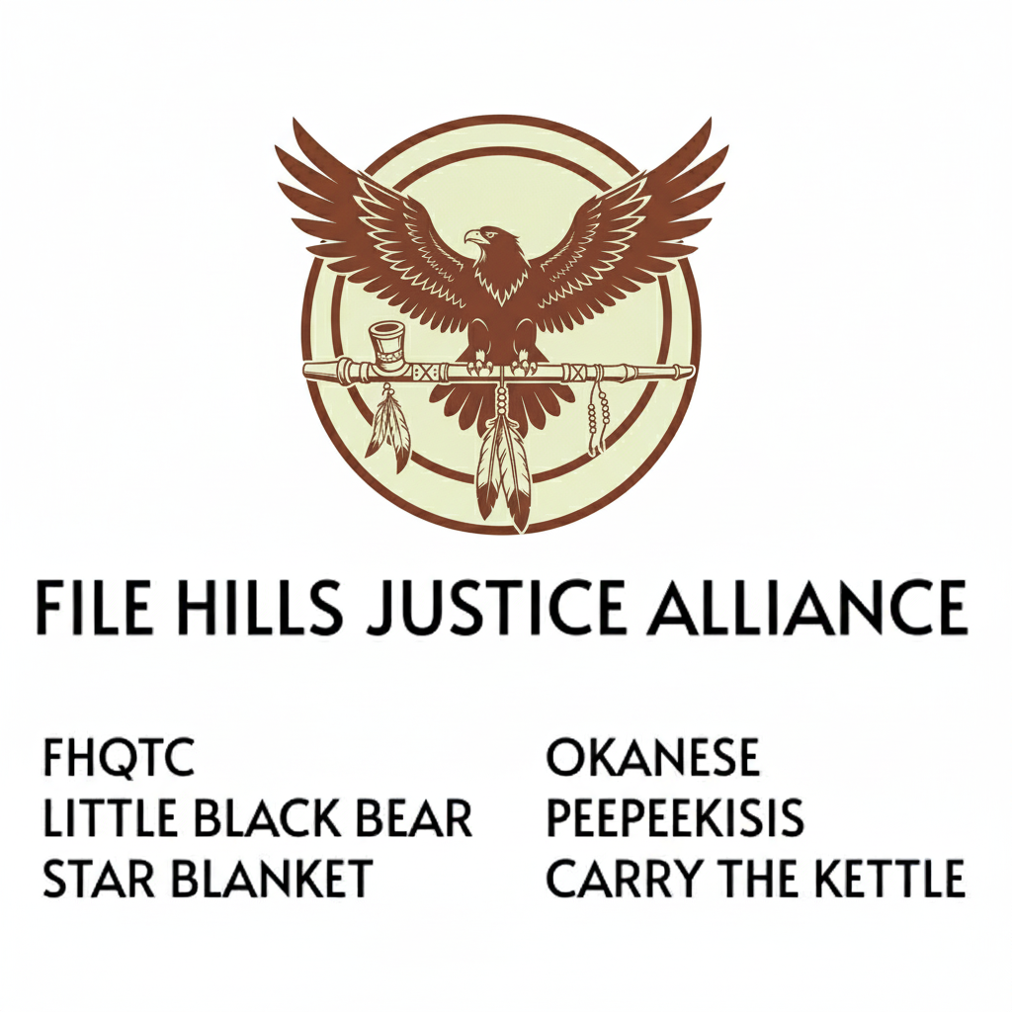
Notes:
Describe our logo and it’s meaning and was created by Alliance Member Ariane Starblanket-James

Slide 3
A Framework for First Nations- Controlled System to Combat Substance Abuse
Background
The Challenge: The First Nations of the File Hills Agency are dedicated to eliminating substance abuse, particularly the operation of drug dealers, in their communities.
Defining Substance Abuse: The document defines this as using substances in an unintended way, from illegal sources, in excessive doses, or in a manner that negatively impacts daily life.
The Vision: To establish a First Nations-directed, supported, and administered system that meets the community's needs and upholds good governance principles.
Notes:
Our journey begins with a clear understanding of the challenge we face. The File Hills First Nations are determined to eliminate substance abuse within our communities. The presence of drug dealers and the impact of illicit substances—like fentanyl, methamphetamines, and others—is a significant concern that affects the safety and health of our people.
For clarity, the 'Terms of Reference' document defines substance abuse not just as use, but specifically as the use of substances in a way that is unintended, from illegal sources, or in a manner that disrupts daily life and relationships. This distinction is important for our focus.
Ultimately, our vision is to establish a system that is fully First Nations-controlled. We want to do the groundwork for a system that is tailored to our unique needs and cultural principles, ensuring that we support good governance from within our communities.
We are not waiting for outside agencies to solve this problem for us; we are taking a focused and directed effort to make this change ourselves.

Slide 4
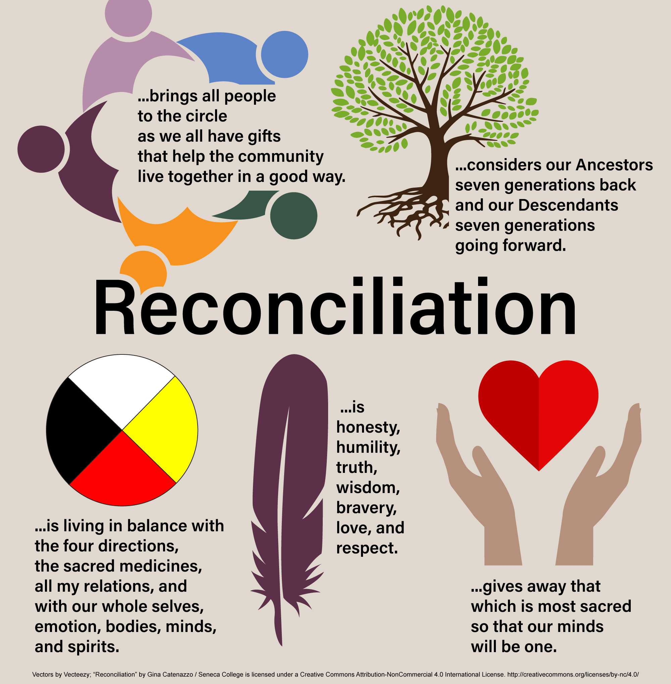
Mandate & Purpose
Our Mandate:
The Justice Alliance will gather facts, provide strategic advice, and develop by-laws and systems to address the illegal distribution and use of illicit drugs.
Our Goal:
To create a First Nations-controlled system to combat substance abuse, responding to the direct input of leadership and communities.
Notes:
The Justice Alliance was created with a clear mandate.
Our primary role is to gather essential information, provide strategic advice to leadership, and develop the by-laws and systems needed to effectively address the illegal distribution and use of narcotics.
We are the architects of this new system. "The most crucial part of our goal is that this will be a First Nations-controlled system. This means that our work will constantly incorporate and respond to the directions we receive directly from our community leadership and citizens. We are building this system from the ground up, with the voice of the community as our guide.

Slide 5
Key Objectives
Objective 1: Trespass By-Law: Develop a framework for a trespass by-law that Nations can use to prevent individuals who endanger community safety from operating on their lands.
Objective 2: Enforcement & Collaboration: Work with the File Hills Board of Police Commissioners and the File Hills First Nations Police Service to create clear policies and procedures for enforcing the by-law.
Objective 3: Dispute Resolution: Assist First Nations in developing their own dispute resolution processes, combining traditional and modern methods like talking circles, mediation, and tribunals based on kinship obligations.
Notes:
Our work is guided by three key objectives. First, we are focused on developing a trespass by-law. This will give our Nations a legal framework to prevent those who endanger our community's safety and security from operating on our lands.
Second, we are committed to enforcement and collaboration. A by-law is only as good as its enforcement. We'll be working closely with the File Hills Police Board and the First Nations Police Service to establish the policies and procedures needed to effectively enforce this by-law.
And finally, our third objective is to support dispute resolution. This is about more than just punishment; it's about healing and restoring balance. We'll be helping Nations develop their own processes that blend both traditional and contemporary methods—things like talking circles, mediation, and tribunals based on our kinship obligations.

Slide 6

Alliance Composition
Who We Are:
Representatives from the File Hills First Nations and the File Hills Qu'Appelle Tribal Council.
Our Expertise:
Members are chosen for their knowledge, skills, and experience in justice, safety, and security. Alliance Members May Include: Portfolio Councilors, Community Justice Committee members, FHFNPS Board members, Nation staff, and interested citizens. The File Hills Qu’Appelle Tribal Council’s Justice Chair will lead the Alliance.
Notes:
The strength of the Justice Alliance lies in its composition. We are a group of dedicated representatives from the File Hills First Nations and the File Hills Qu'Appelle Tribal Council.
Our members are selected for their deep knowledge, skills, and direct experience with justice, safety, and security matters in their own communities. The Chair of the Alliance is from the Tribal Council, providing essential leadership.
Our membership is broad and inclusive, and can include Portfolio Councilors, members of Community Justice Committees, Police Board members, Nation staff, and any interested citizen.
This diversity of experience ensures we have a holistic and grounded perspective on the issues we are addressing.

Slide 7
Current FHJA Members
Peepeekisis Cree Nation: Lead/Chair: Blaine Pinay, Elder Lyndia Poitras, Carla Nokusis & Bev Poitras
Little Black Bear Band: Lead-Dan Bellegarde, Elder Muriel Bellegarde, Becky Bellegarde
Star Blanket Cree Nation: Lead-Ariane Starblanket-James, Sharidy Desnomie, Elders-Cecil Lowe, Anita Bigknife, Kevin Starr, Justice Portfolio-Cathy Stonechild & Mike D Starr
Okanese First Nation: Lead-Clarence Stonechild, Justice Portfolio-Edward Dumont & Tyson Creeley
Carry the Kettle First Nation: Elder-Sandee Fitzgerald & Justice Portfolio-Treena Bellegarde
File Hills Qu’Appelle Tribal Council-Justice Department: Lead Reagan Delorme & Staff
File Hill Police Services: Chief of Police & Staff
Notes:
Announce each Nation and FHJA member-name
the selection of the FHJA came from their own leadership

Slide 8

Roles & Responsibilities
Community Support: The Alliance provides support for the development of community-based laws and policies to ensure a safe and secure environment.
Communication & Information: We will ensure good communication regarding justice developments through regular meetings (each community will rotate hosting the alliance meetings) and information sessions with representatives from police, courts, corrections, and First Nation justice advocates.
Advisory Role: The Alliance will act as a sounding board for federal and provincial officials, and provide advice and recommendations to First Nation leadership and Community Justice Committees
Notes:
Our day-to-day role is multifaceted.
We provide direct support for the development of community-based laws and policies. We are here to help turn community-led ideas into actionable frameworks that promote safety and security.
Communication is key. We will ensure there is a regular flow of information on justice developments across the area through scheduled meetings and sessions with police, court, and corrections representatives, as well as First Nation justice advocates. This is about building bridges and a shared understanding.
Finally, we also serve as an important advisory body. The Alliance will act as a sounding board for federal and provincial officials on justice-related matters, providing valuable advice and feedback from a First Nations perspective. This ensures our voice is heard at all levels of governance

Slide 9

Administration & Logistics
Secretariat Support: The File Hills Qu'Appelle Tribal Council will provide administrative support & research additional sources of funding, Professional development training (Justice Committee Training-etc.), assistance in community safety/justice engagements/gatherings/forums.
Meeting Documentation: Summaries will be documented and distributed to members within two weeks of each meeting. (Admin Technician-Ariane Starblanket-James)
Travel Expenses: Members' travel will be covered by their respective communities or organization. (Justice &/or Community Safety Plan-Funding)
Notes:
To ensure the Alliance runs smoothly, we have a clear administrative structure. The File Hills Qu'Appelle Tribal Council will provide full secretariat support, handling the logistics and administration of our work.
We will maintain a strong paper trail. Meeting summaries will be documented and made available to all Alliance members within two weeks, ensuring everyone is kept up-to-date and informed on our progress.
And finally, to support our members' participation, travel expenses for Alliance members will be paid by their respective communities or organizations, ensuring that we can all be present and contribute to this important work."

Slide 10
Elders Gathering Directives Summary (Hoested: 3 Gatherings)
This document outlines the priorities of the Elders Alliance from five First Nations, focusing on community well-being, justice, and cultural revitalization.
Key Areas of Focus:
Community Safety & Well-being: The Elders Alliance emphasizes that communities are responsible for their own safety. They encourage each community to develop and enforce its own safety plan and bylaws, with a current focus on creating a trespassing by-law. This includes a push for individuals to feel safe speaking out and for those who cause harm to be held accountable.
Justice System Reform & Indigenous Approaches: The Alliance advocates for the development of Indigenous Courts using a "two-eyed seeing" approach, which combines modern and restorative justice with Indigenous principles. They highlight the need for more First Nation judges and lawyers to reduce incarceration rates. Other priorities include changes to the police system, such as tiered policing with community-based officers, and the handling of family law matters at the band level.
Culture, Tradition & Education: A core priority is to strengthen community circles through relationship building and bringing back traditional values and ceremonies. The Alliance believes that integrating culture back into the justice system is crucial, as is educating youth from a young age on their culture and traditional laws through land-based teachings and full immersion camps.
Programs & Resources: The document calls for rehabilitation and reintegration programs that focus on land-based healing, and the expansion of successful youth programs like the Iron Nation Rangers' program. It also emphasizes the need for increased resources and funding, and a greater role for elders and youth in program development.
Notes:
Now, we're going to discuss the core priorities and directives that emerged from the recent Elders Gathering. This document, the 'Elders Gathering Directives Summary,' represents a collective vision for our communities. It’s a roadmap for enhancing well-being, strengthening justice, and revitalizing our culture. We are not just presenting a plan; we are sharing a vision guided by the wisdom of our Elders.
The first key area of focus is on Community Safety and Well-being. The directives emphasize that each community should be empowered to create and implement its own safety plan. This is a move toward self-determination, recognizing that we know our communities best. A crucial principle that came out of the gathering is the need to foster an environment where individuals feel safe to speak up. This means creating a culture of trust and support, where community members can report concerns without fear of retaliation. The message is clear: while we value partnerships, we are taking responsibility for our own safety. We are moving away from the mindset of solely relying on external government agencies and toward building our own capacity for crime prevention and accountability.
Next, the directives call for significant Justice System Reform. The Elders highlighted the need for Indigenous Courts that use a 'two-eyed seeing' approach. This means blending the best of both contemporary and traditional justice systems to create a more effective, holistic approach A practical goal is to advocate for more First Nations judges and lawyers. Having our own people in these roles will ensure better advocacy and a deeper cultural understanding within the legal system. Ultimately, the goal is to shift the focus from punishment to rehabilitation and healing. By addressing the root causes of harm, we can lower incarceration rates and improve the overall perception of justice within our communities.
The youth are the future, and a significant portion of the directives is dedicated to Youth and Education. The Elders were very clear about the need to empower our young people with the skills and knowledge to thrive. This includes teaching them respect, accountability, and life skills. The 'two-eyed seeing' approach is central to this. We must help our youth navigate and succeed in both our traditional Indigenous way of life and the wider contemporary society. This duality is a source of strength, not a conflict. The directives also call for us to define crime prevention, anti-bullying, and anti-gang strategies from our own Indigenous perspective. This ensures that the solutions are culturally appropriate and effective for our communities. The final area of focus is on Programs and Resources. The directives highlight the importance of land-based healing. This is a holistic approach that integrates mental, physical, and spiritual health—recognizing that true wellness is connected to the land. The directives also encourage us to replicate successful models, like the Iron Nation Rangers program, and expand them to other bands. This is about sharing what works and building on our successes. Finally, there's a strong call to action for increased resources and support. This includes greater funding, but also, critically, a call for more involvement from both our Elders and our youth in designing and implementing these programs. This ensures that our initiatives are not only well-funded but also truly representative of our community's needs and talents.

Slide 11
Thank You, for your commitment to creating a safer and more secure future for our communities.
Questions & Comments?
Next Gathering: Date & Venue-TBA
Youth Forum/Directives for FHJA
Next FHJA Meeting:
Host-Carry the Kettle

