Slide 1
Emergency Management in First Nation Communities – Lessons from the 2025 Emergency Season and the Path Toward a Multilateral Emergency Management Agreement
October 29, 2025
Presented by Serge Beaudoin & Rob Harvey

Slide 2
Purpose
Review of 2025-2026 Wildfire Season
Provide an update on the work ISC has done so far towards addressing the recommendations of the Auditor General of Canada’s (AG) audit of emergency management in First Nations communities
Provide an update on the status of developing a Multilateral Emergency Management Agreement in Saskatchewan and next steps

Slide 3
2025-2026 Wildfire Season in Saskatchewan
Since April 15, 2025, 24 Saskatchewan First Nations have been impacted by wildfires; 10 experienced evacuations due to fire threats or smoke.
Approximately 11,540 people were displaced, with 4 communities facing long-term evacuations and 2 communities experiencing infrastructure loss causing continued displacement.
First Nations led emergency preparedness, response, and recovery, managing evacuations and ensuring cultural, heath and mental supports for evacuees.
We deeply acknowledge the profound impacts this fire season has had on First Nations communities in Saskatchewan- the disruption, losses and challenges faced- and we honor the strength, resilience, and leadership shown by Chiefs, Emergency Management coordinators, and community members in navigating these difficult times.
The Multilateral Emergency Management Table provides an opportunity for leaders and emergency responders to share their after-action reports, identify gaps and collaborate on improvements before the next wildfire season.

Slide 4
Open Session: Key Takeaways from 2025-2026 Wildfire Season
What worked well?
What areas need improvement?

Slide 5
Overview: Scope and findings of the OAG 2022 Audit
The audit examined Indigenous Services Canada’s supports to First Nations to manage emergencies related to floods, wildfires, landslides, and severe weather events.
The audit covered the period from April 1, 2018 to March 31, 2022.

Slide 6
OAG Report: ISC Response Updates
ISC accepted the AG’s findings and agreed with the seven recommendations laid out in the report.
Updates on the status of ISC’s response are as follows:
Recommendation | Key Milestones | Status | Due Date
Risk-Based Approach | Enhanced EMAP funding formula Developed a Highest Risk Communities list From April 1, 2024, EMAP program leveraging formula in their regional allocations and risk tools in their proposal decision making process | MRAP Commitment Met | April 2024
Unfunded Structural Mitigation Projects | As of September 30, 2025, 39 out of the initial 112 unfunded structural mitigation projects identified in the Auditor General’s report remain a priority for First Nation communities. The other 73 projects from the initial 112 projects, identified in the Auditor General’s report, have been closed. 5 projects of the 39 projects have not yet received funding | On Track | March 2028
Service Agreements | Service agreements are in various stages of negotiations in several regions. Governance structures to advance conversations with FNs and PTs developed in most regions. Partners in the Atlantic provinces are close to finalizing agreements in Prince Edward Island (2), and Newfoundland and Labrador (1). In BC, phase 1 discussion have recently concluded and as an outcome, 34 additional Emergency Management Coordinator positions will be funded in BC First Nations communities and organizations. | On Track | April 2027
Emergency Management Coordinators (EMC) | Identified high risk communities using a risk-based approach As of September 2025, ISC now supports over 300 EMC positions | MRAP Commitment Met | April 2024

Slide 7
OAG Report: ISC Response Update (con’t)
Recommendation | Key Milestones | Status | Due Date
EM Plans | Existing National Plan updated and published online Regional plans have all been updated and will be published online late Fall 2025 By end of January 2026, all EM plans will have been reviewed as per agreed 2-year review cycled. | National Plan: Commitment Met Regional Plan: On Track | April 2024
Performance Indicators | 19 new indicators in place All indicators linked to the United Nations Sustainable Development goals Review and publication of select indicator results scheduled for Fall 2025 | On Track | Fall 2025
Comparable and Culturally Appropriate EM Services | ISC defined comparable services, developed Interim Service Standards and After-Action reports which are publicly available and shared with emergency management service delivery partners across all regions. | MRAP Commitment Considered Met | April 2024

Slide 8
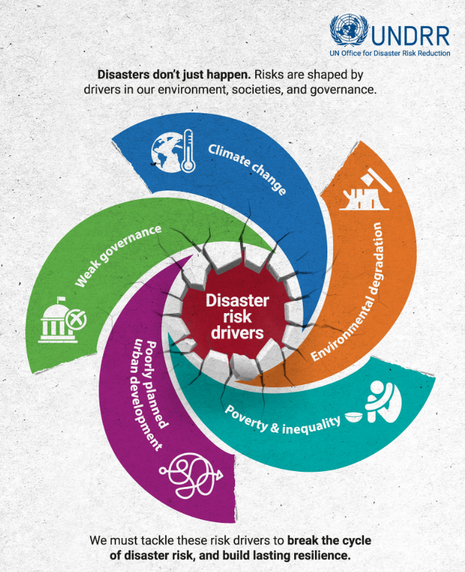
UNDRR Disaster Risk Drivers

Slide 9
Multilateral Emergency Management Agreement Progress in SK
Winter 2024
Multilateral meetings began involving 5 Tribal Councils, ISC and SPSA
Spring 2025
The original 5 Tribal Councils joined with additional Tribal Councils and Independant First Nations to establish a Multilateral Emergency Management Working Group
Fall 2025
A Terms of Reference for the Working Group has been developed and reviewed by all parties which outlines roles, responsibilities and objectives
Next Steps
The Working Group is co-chaired between ISC and Grand Chief Hardlotte of Prince Albert Grand Council
Develop a multilateral emergency management agreement in collaboration with First Nation Partners

Slide 10
ANNEX 1: AG’s 2022 Recommendations (1-4)
8.32 Indigenous Services Canada should work with First Nations to implement a risk-based approach to inform program planning and decisions on where to invest in preparedness and mitigation activities to maximize support to communities at highest risk of being affected by emergencies.
8.36 Indigenous Services Canada should work with First Nations communities to address the backlogs of eligible but unfunded structural mitigation projects and unreviewed structural mitigation projects to effectively allocate resources to reduce the impact of emergencies on First Nations communities.
8.39 Indigenous Services Canada should, on the basis of an assessments of risks, regularly update outdated departmental and regional emergency management plans and take immediate action to develop regional emergency management plans for the 3 regions that do not have them. These plans should be used to make informed decisions and take concrete actions to assist First Nations communities with managing the risks related to emergencies.
8.42 Indigenous Services Canada, in collaboration with First Nations, should determine how many emergency management coordinator positions are required and allocate funding for these positions on the basis of risk and need to ensure First Nations have sustained capacity to manage emergencies.

Slide 11
ANNEX 2: AG’s 2022 Recommendations (5-8)
8.62 Indigenous Services Canada should, in collaboration with First Nations, provincial governments and other service providers, ensure that First Nations communities receive the emergency management services they need by;
establishing emergency management service agreements and wildfire agreements in all jurisdictions that include all First Nations
establishing mutually agreed-upon evacuation service standards in the jurisdictions that lack such standards
increasing support for First Nations-led approaches to emergency management
8.66 Indigenous Services Canada should develop performance indicators to allow the department to measure progress against the United Nations’ Sustainable Development Goals and use these indicators to track and report publicly on progress.
8.68 Indigenous Services Canada should, in collaboration with First Nations, provincial governments and other service providers, ensure that First Nations communities receive the emergency management services they need by:
Defining what is meant by comparable services for First Nations in relation to those available to municipalities of similar size and circumstance in each jurisdiction.
Monitoring the services provided to First Nations to ensure that they are comparable to services provided to non-Indigenous communities, are culturally appropriate, and address the needs of marginalized groups.
Identifying and addressing shortcomings by monitoring emergency management service agreements and conducting lessons-learned exercises.

