Slide 1
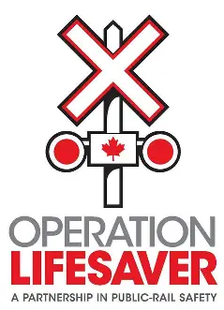

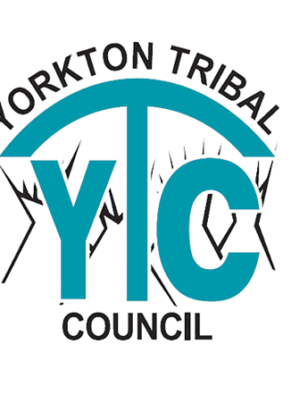
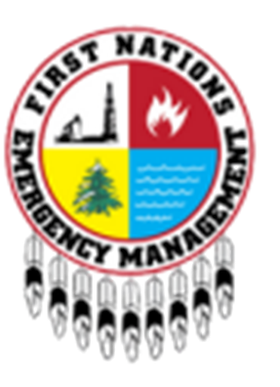
2025 Saskatchewan First Nation Emergency Mangement Forum
Peter Dobrowolski – Operation Lifesaver Canada

Slide 2
Video Unavailable

Slide 3
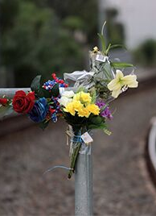
Numbers Don’t Lie: Urgent Action Needed
Every year, more than 100 Canadians face life-altering injuries or fatalities due to railway incidents. These incidents impact individuals, their loved ones, first responders, railroaders, and communities. And each incident is preventable, making even one too many.
Railway incidents represent real people and losses. In 2024, Canada recorded 901 rail accidents, including 167 crossing incidents and 94 trespassing incidents, resulting in 70 fatalities and 67 serious injuries.
These figures highlight the need for collaboration with municipalities and community leaders to achieve zero incidents.

Slide 4
About Operation Lifesaver
Founded in 1981 as a national public rail-safety program.
Partnership between rail industry and government.
Mission: Prevent deaths and injuries around railway tracks and trains.
Programs delivered across Canada by coordinators and volunteers.

Slide 5
Why Rail Safety Matters
There are about 14,000 public and 9,000 private grade crossings along more than 40,000 kilometres of federally regulated railway tracks in Canada.
Trains can take up to 2 km to stop.
Incidents affect families, communities, and railway workers.
Many Indigenous and rural communities are located near rail corridors.

Slide 6


Operation Lifesaver’s Approach
Education – School programs and digital campaigns.
Community Engagement – Partnering with local leaders and organizations.
Collaboration – Working with police, fire, EMS, and government agencies.
Respectful Partnerships – Building trust through understanding and respect.

Slide 7
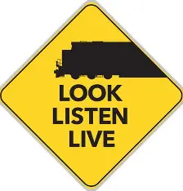
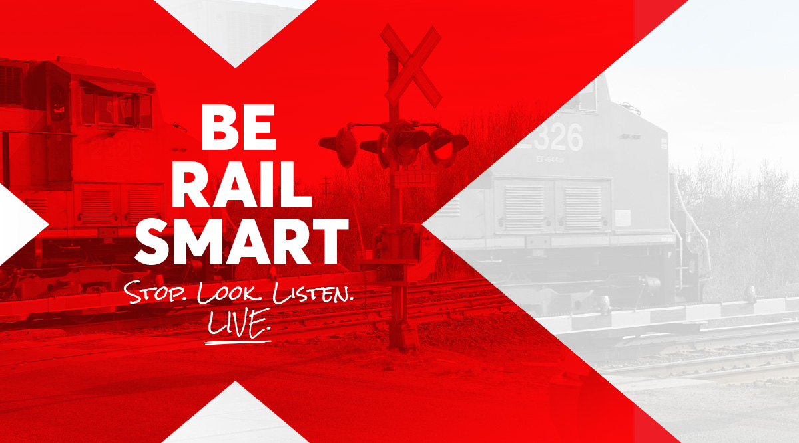
Community Programs and Partnerships
Partnering with schools, youth organizations, and safety councils.
Engaging at agricultural fairs, expos, and local events.
Collaboration with the Canadian Red Cross and agricultural safety programs.
Promoting safety through shared community leadership.

Slide 8
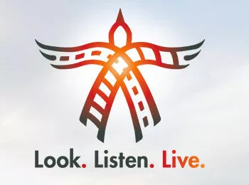
Working with Indigenous Communities
Many Indigenous communities live close to active railways.
OL collaborates respectfully with leaders, elders, and youth.
Programs tailored to reflect community traditions and values.
Workshops and presentations held in First Nations communities nationwide.

Slide 9
Sharing Knowledge and Resources
Culturally relevant educational materials and safety messaging.
Support for Treaty Days, Pow Wows, and community events.
Educational resources adapted into local languages when possible.
Promoting 'Look. Listen. Live.' across all communities.

Slide 10
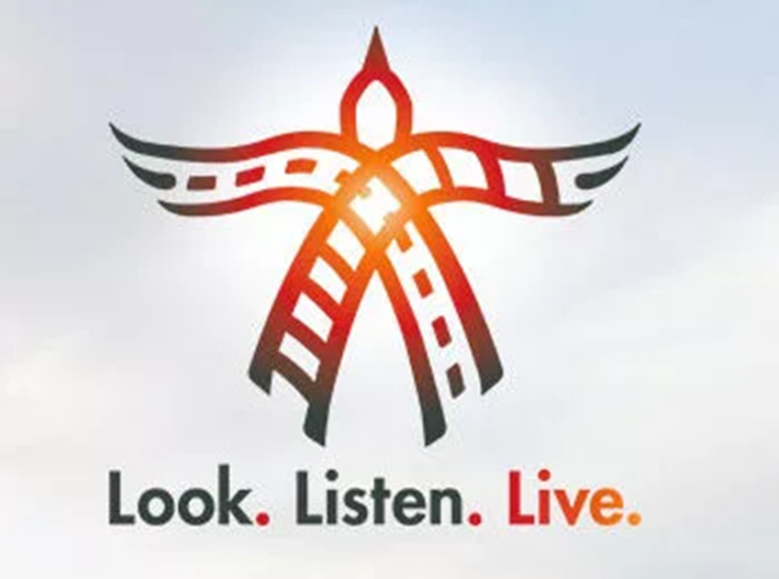
Supporting First Responders
Rail Safety Tips for Emergency Responders It takes teamwork to deal with any incident on railway tracks and property. Emergency responders play an essential role on the front line.
COMMUNICATE WITH THE RAILWAYS Make sure you notify all relevant railway companies before approaching any incident near their tracks or property. Share the exact location of the incident (such as the milepost, road name and town) with the railway. Railway companies post their emergency numbers and crossing locations on a blue sign under the crossbuck or near the crossing this information may also be displayed on a nearby signal house. Ensure all rail traffic is stopped in the area. When the incident response is complete and personnel have been cleared, inform the railway company so they can resume operations.

Slide 11

Supporting First Responders
PROCEED WITH CAUTION Park all emergency vehicles no closer than 5 metres from the nearest rail. Don’t walk directly on the tracks to get to the incident or go between or underneath railway cars. Stay alert, look in both directions and listen for trains before approaching or crossing tracks – evenafter you’ve contacted the railway company to stop rail traffic.
ENSURE YOU’RE VISIBLE After you have notified the railway and confirm all rail traffic is stopped.

Slide 12

Supporting First Responders
CONTACT THE TRAIN CREW Try to contact the train crew to determine their situation but be aware that they may be suffering from injury or shock.
PLAN AHEAD Know which railway companies operate in your area and work with them to produce an effective emergency response procedure. Make sure you know the appropriate protocol for handling railway incidents. Have emergency numbers for all railways and emergency dispatchers.

Slide 13
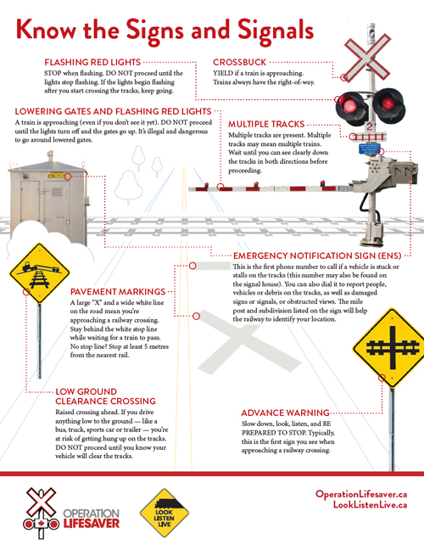

Slide 14
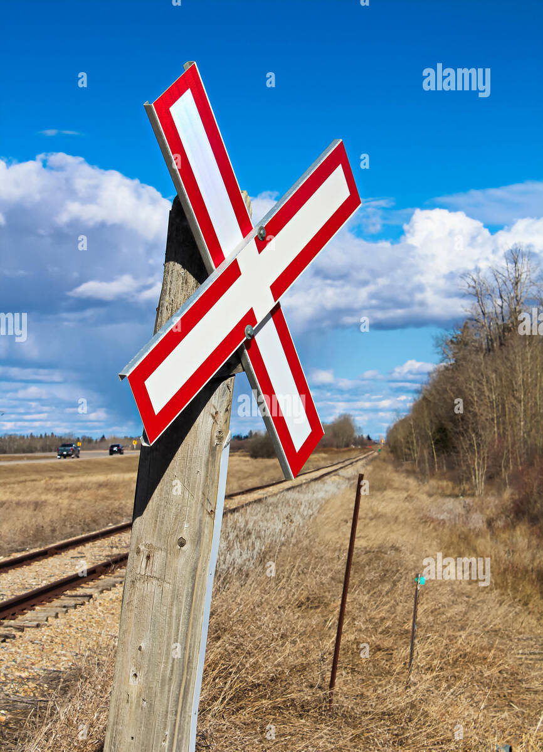
Crossbuck
YEILD if a train is approaching.
Trains always have the right-of-way

Slide 15
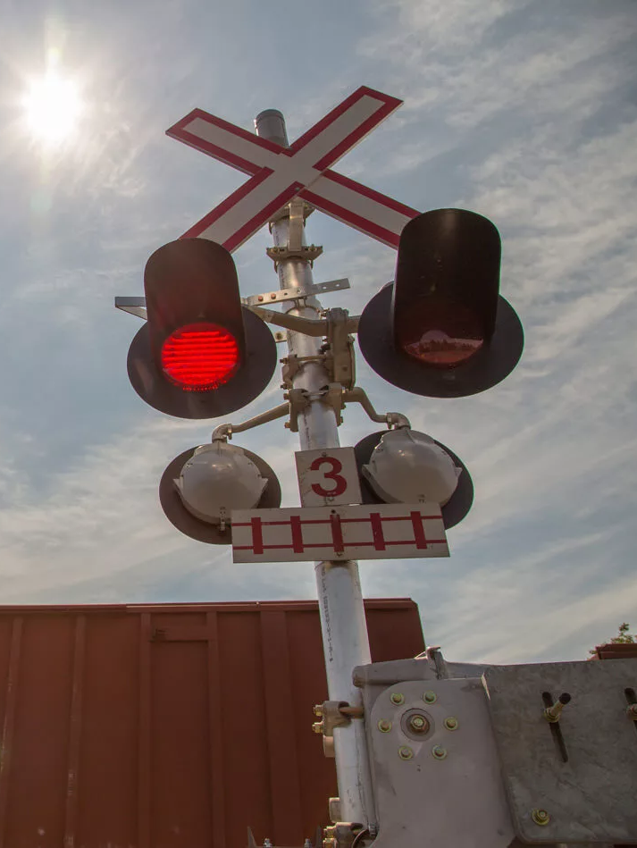
MULTIPLE TRACKS
Multiple tracks are present.
Multiple tracks may mean multiple trains. Wait until you can see clearly down all tracks in both directions before proceeding.

Slide 16
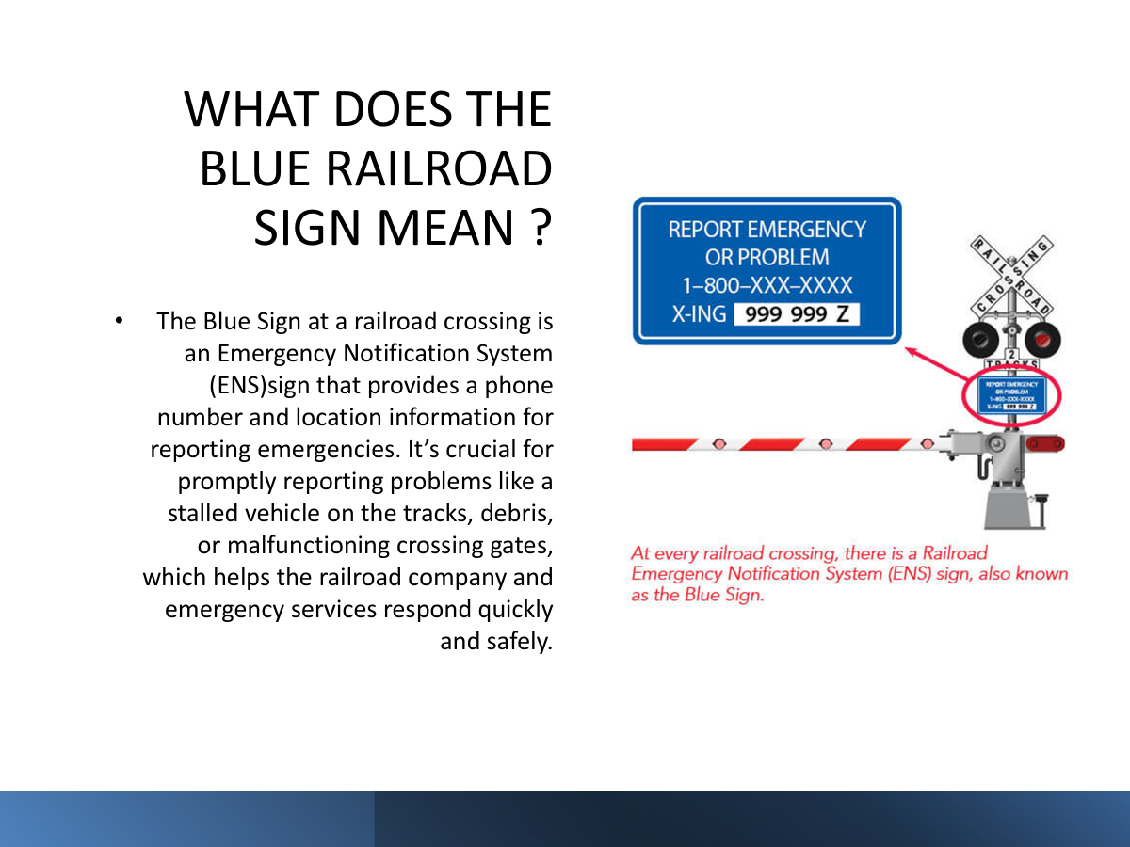
EMERGENCY NOTIFICATION SIGN(ENS)

Slide 17
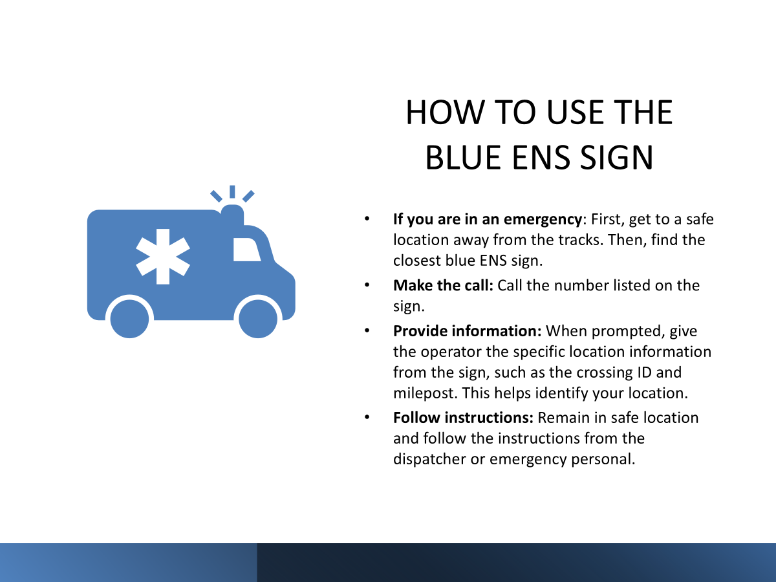

Slide 18
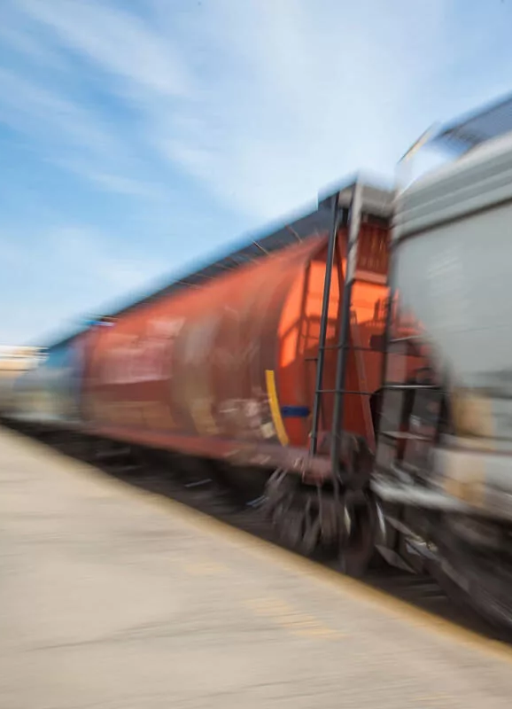
Education the Cornerstone of Prevention
Partnerships with the Proximity Initiative inform land use planning and development near rail corridors, reducing risks and resolving potential conflicts proactively.
The Operation Lifesaver Canada “Look. Listen. Live.” program empowers Canadians to make safe choices around railways. This award-winning campaign uses videos, social media, and other tools to remind people of three simple actions: look, listen, and live.
Education and outreach activities are tailored to each participant to resonate locally. Grassroots efforts are amplified through partnerships with schools, workplaces, and community organizations, ensuring rail-safe messages reach and resonate with audiences.

Slide 19

Take Charge Of Safety In Your Community
Achieving zero rail-related incidents, deaths, and injuries requires collective action. Local leaders can join this life-saving mission to:
identify and address high-risk areas
educate residents about rail safety
implement preventative measures
Working together, we can create a future free of devastating railway incidents. Every life matters, and every tragedy is one too many.
Let’s build safer communities, one crossing, one conversation, one action, and one life at a time. Let’s get to zero, together.

Slide 20
Video Unavailable

Slide 21

Summary and Call to Action
Together, we can make railways and communities safer.
Partnerships between Indigenous leaders, responders, and educators matter.
Encourage everyone to spread the message: 'Look. Listen. Live.'
Join Operation Lifesaver as a Rail Safety Ambassador today!

Slide 22

Becoming a Rail Safety Ambassador
Open to anyone passionate about promoting safety.
Ambassadors host presentations, events, and online awareness.
Free online training provided by Operation Lifesaver.
Recognition and support for community leadership.

Slide 23
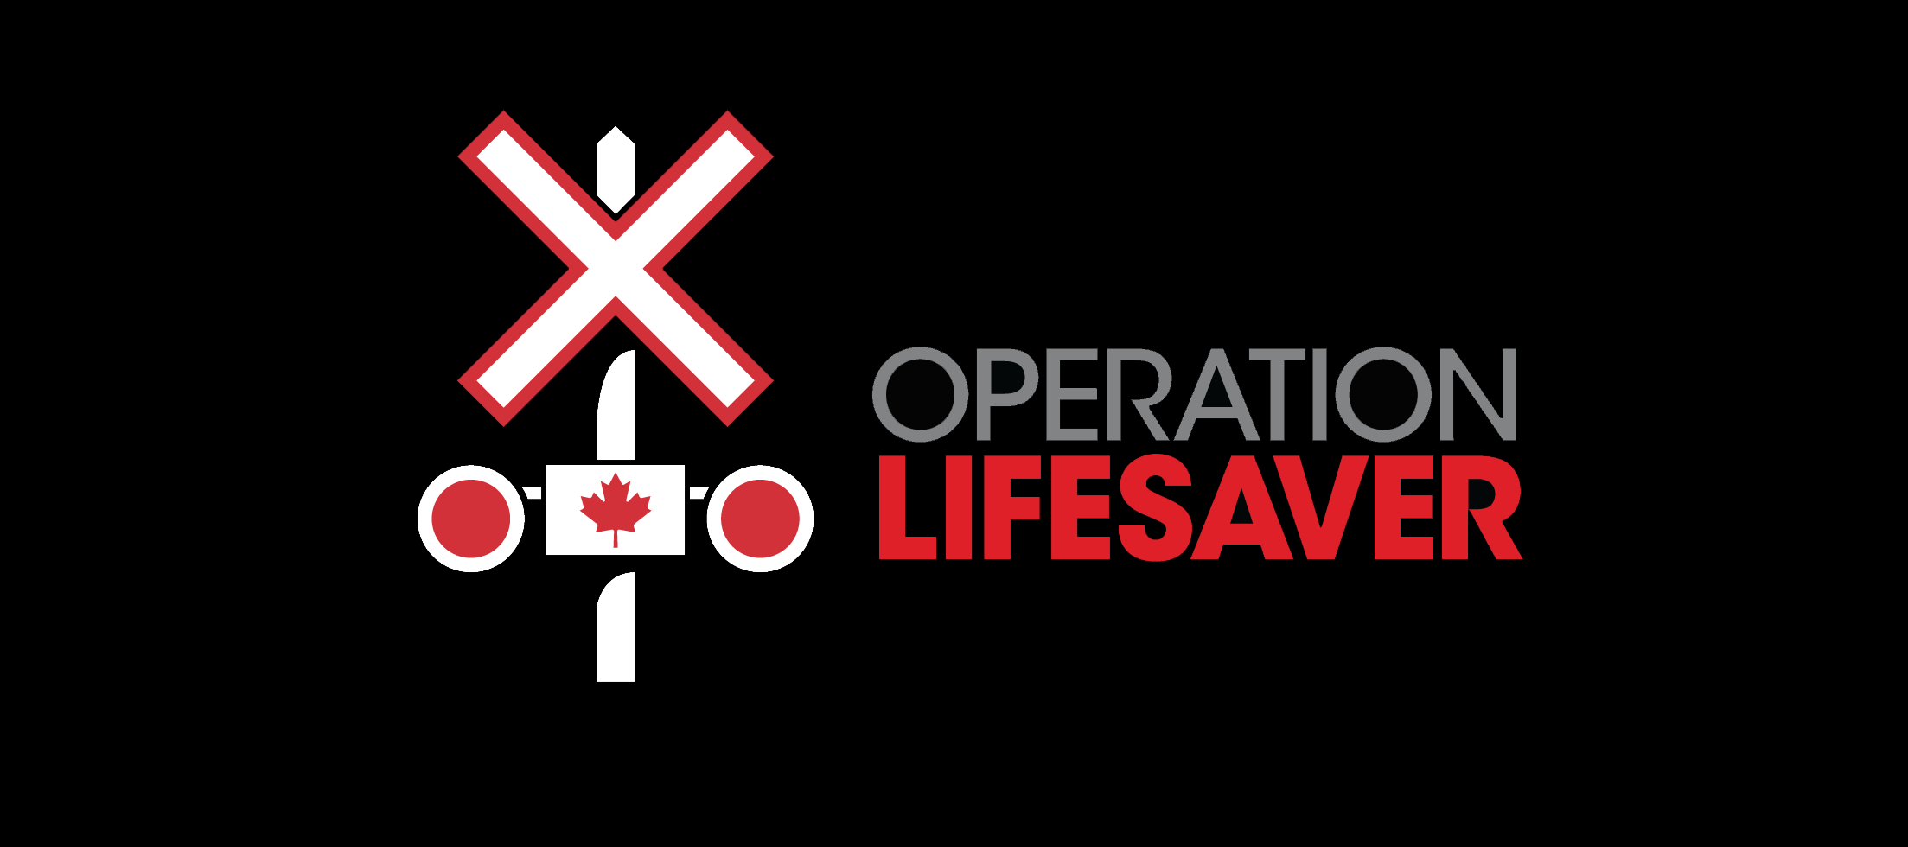
How to Join
Visit www.operationlifesaver.ca.
Click on 'Rail Safety Ambassadors.'
Complete short online registration and training modules.
Start promoting rail safety in your community.

Slide 24
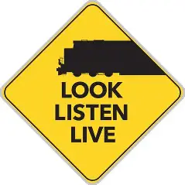
Questions / Discussion
Thank you for your time and commitment to community safety.
Learn more at: www.operationlifesaver.ca
Follow on social media: @oplifesaver
Together, we can prevent rail tragedies.

